Slide 1
Coupledline Compiled Data
2025-08-22_05_30

Slide 2
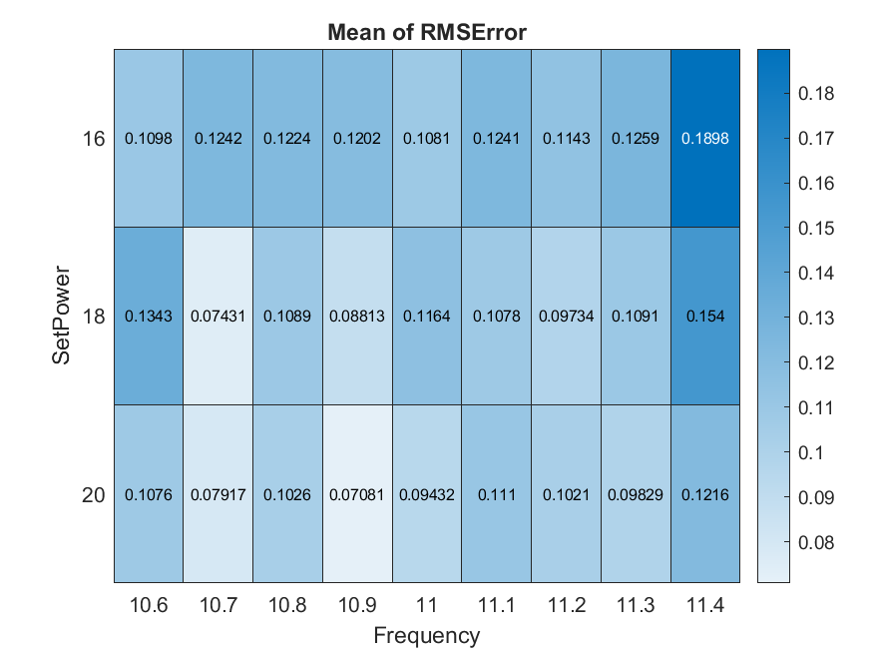
Bias 1

Slide 3
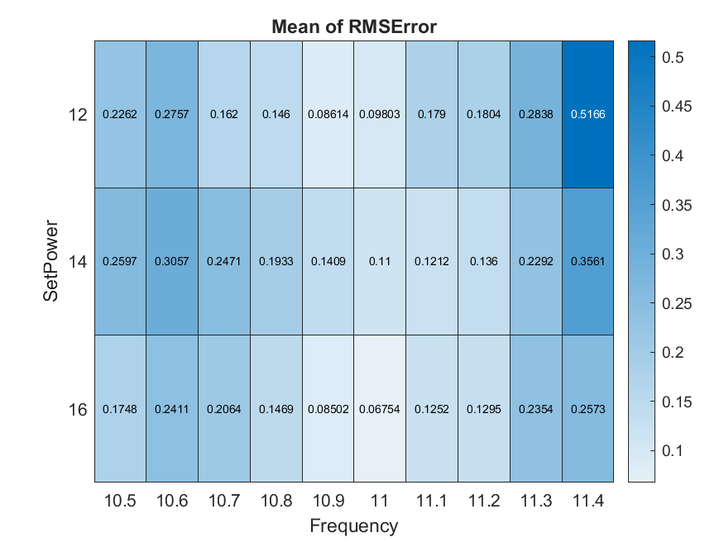
Bias2

Slide 4
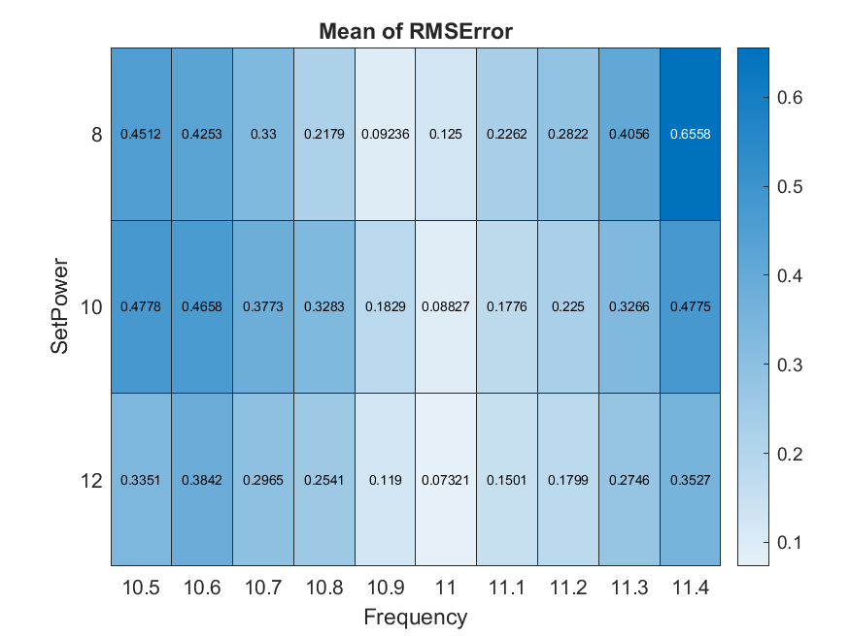
Bias 3

Slide 5
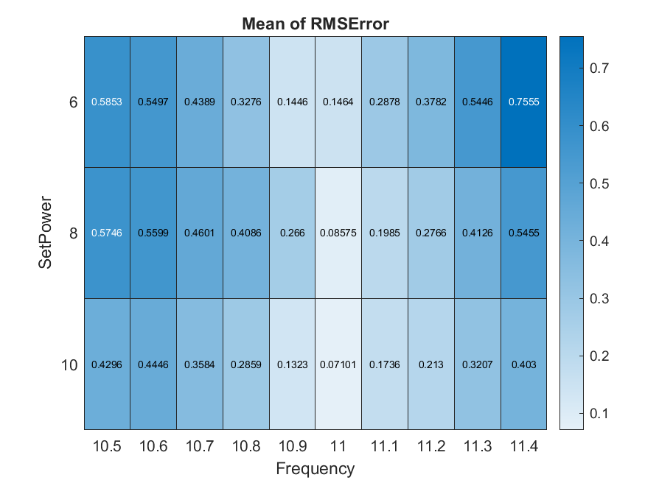
Bias 4

Slide 6
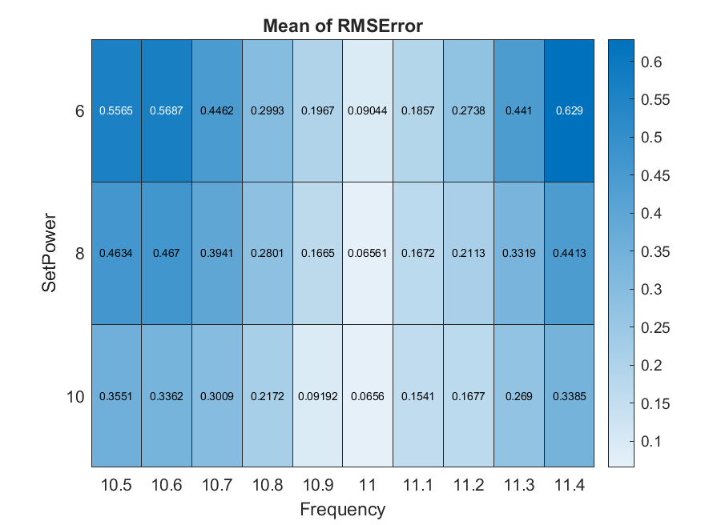
Bias 5

Slide 7
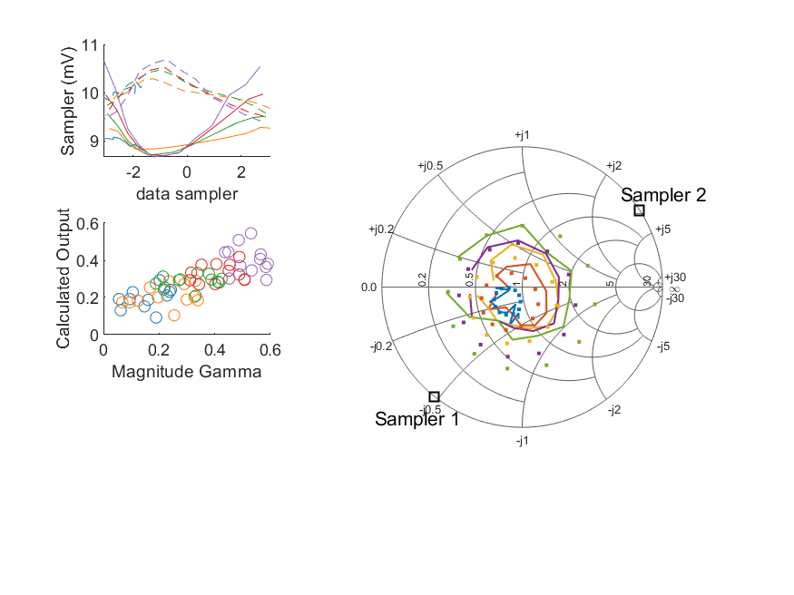
Coupled Line Performance At 10.60 GHz, 16.000000 dBm Output Power 1.00 V mean sampler bias
Sampler Av
Sampler 1: 251.384
Sampler 2: 291.297
Sampler Offset (rather than -1)
-5.1350058650820776
Sampler 1 Range
0.00199
Sampler 2 Range
0.00128
DUT output dBm Mean
15.97700
DUT input dBm Mean
16.53687
RMS Error
0.10980

Slide 8
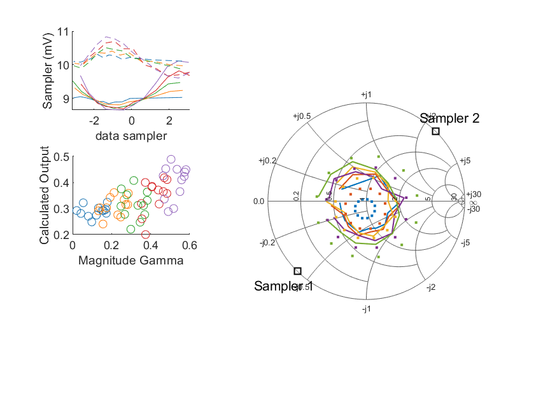
Coupled Line Performance At 10.70 GHz, 16.000000 dBm Output Power 1.00 V mean sampler bias
Sampler Av
Sampler 1: 251.384
Sampler 2: 291.297
Sampler Offset (rather than -1)
-5.1350058650820776
Sampler 1 Range
0.00146
Sampler 2 Range
0.00123
DUT output dBm Mean
16.00637
DUT input dBm Mean
16.43286
RMS Error
0.12416

Slide 9
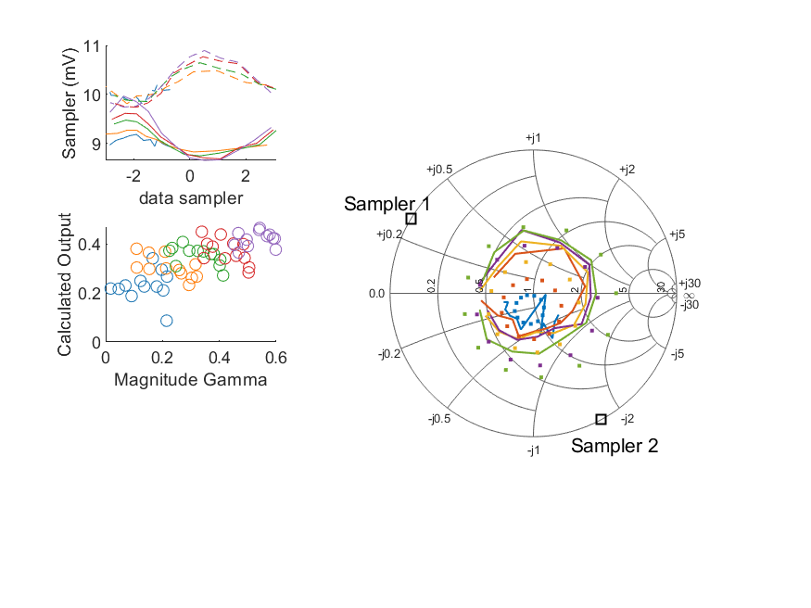
Coupled Line Performance At 10.80 GHz, 16.000000 dBm Output Power 1.00 V mean sampler bias
Sampler Av
Sampler 1: 251.384
Sampler 2: 291.297
Sampler Offset (rather than -1)
-5.1350058650820776
Sampler 1 Range
0.00131
Sampler 2 Range
0.00116
DUT output dBm Mean
15.99252
DUT input dBm Mean
16.44173
RMS Error
0.12235

Slide 10
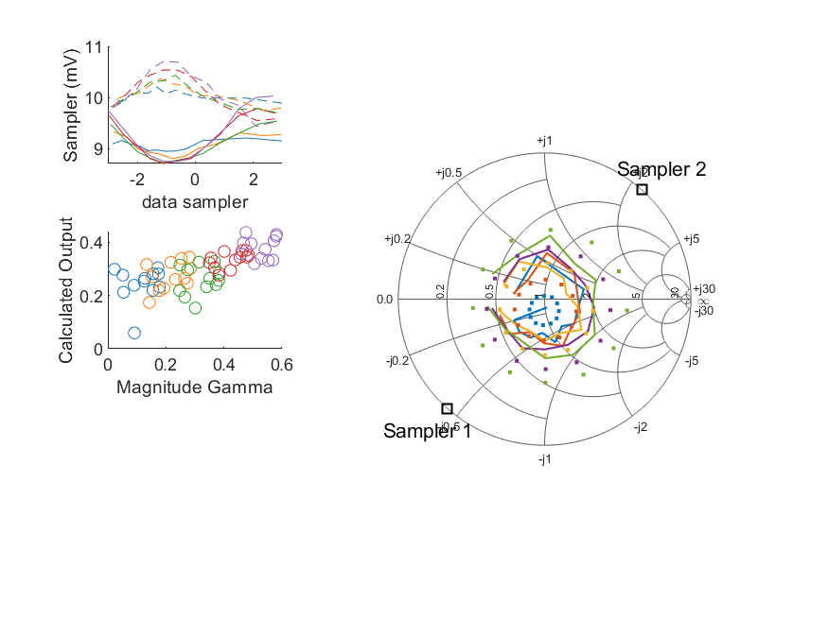
Coupled Line Performance At 10.90 GHz, 16.000000 dBm Output Power 1.00 V mean sampler bias
Sampler Av
Sampler 1: 251.384
Sampler 2: 291.297
Sampler Offset (rather than -1)
-5.1350058650820776
Sampler 1 Range
0.00132
Sampler 2 Range
0.00127
DUT output dBm Mean
15.98133
DUT input dBm Mean
16.50231
RMS Error
0.12019

Slide 11
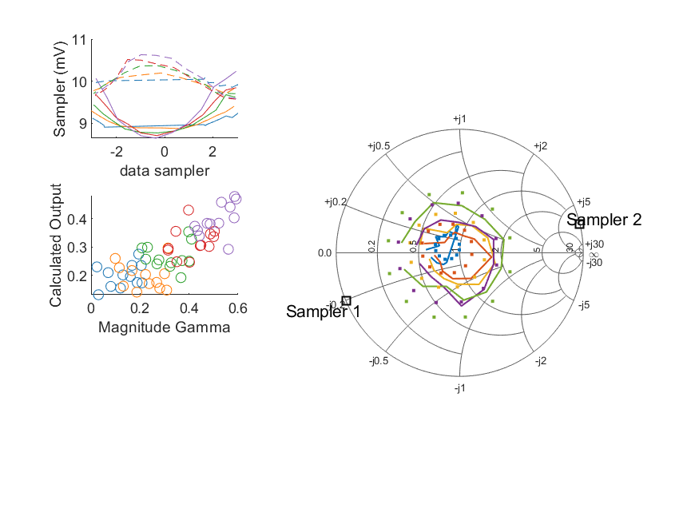
Coupled Line Performance At 11.00 GHz, 16.000000 dBm Output Power 1.00 V mean sampler bias
Sampler Av
Sampler 1: 251.384
Sampler 2: 291.297
Sampler Offset (rather than -1)
-5.1350058650820776
Sampler 1 Range
0.00160
Sampler 2 Range
0.00106
DUT output dBm Mean
16.01625
DUT input dBm Mean
16.45544
RMS Error
0.10807

Slide 12
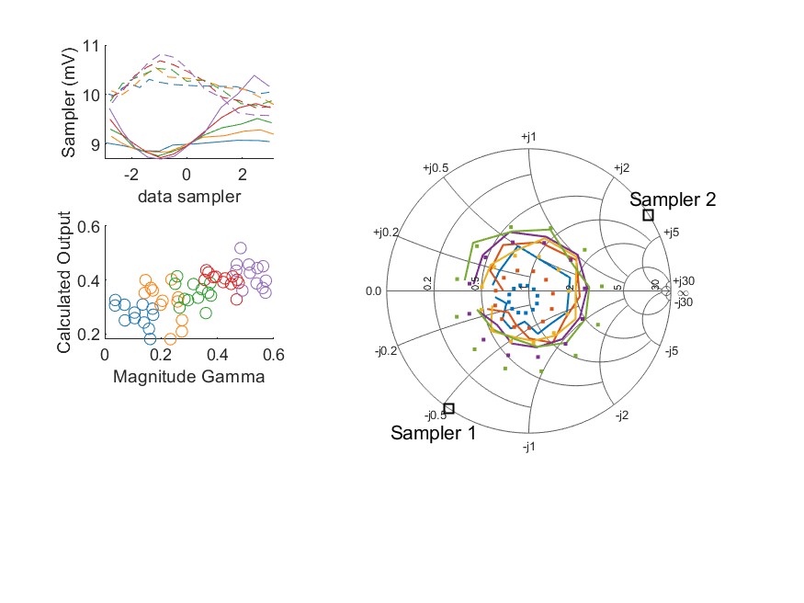
Coupled Line Performance At 11.10 GHz, 16.000000 dBm Output Power 1.00 V mean sampler bias
Sampler Av
Sampler 1: 251.384
Sampler 2: 291.297
Sampler Offset (rather than -1)
-5.1350058650820776
Sampler 1 Range
0.00169
Sampler 2 Range
0.00124
DUT output dBm Mean
16.03071
DUT input dBm Mean
16.51571
RMS Error
0.12408

Slide 13
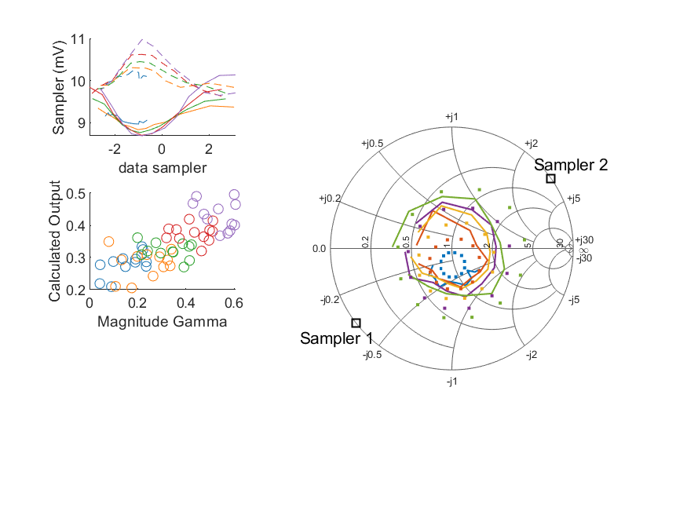
Coupled Line Performance At 11.20 GHz, 16.000000 dBm Output Power 1.00 V mean sampler bias
Sampler Av
Sampler 1: 251.384
Sampler 2: 291.297
Sampler Offset (rather than -1)
-5.1350058650820776
Sampler 1 Range
0.00145
Sampler 2 Range
0.00135
DUT output dBm Mean
16.01870
DUT input dBm Mean
16.53604
RMS Error
0.11431

Slide 14
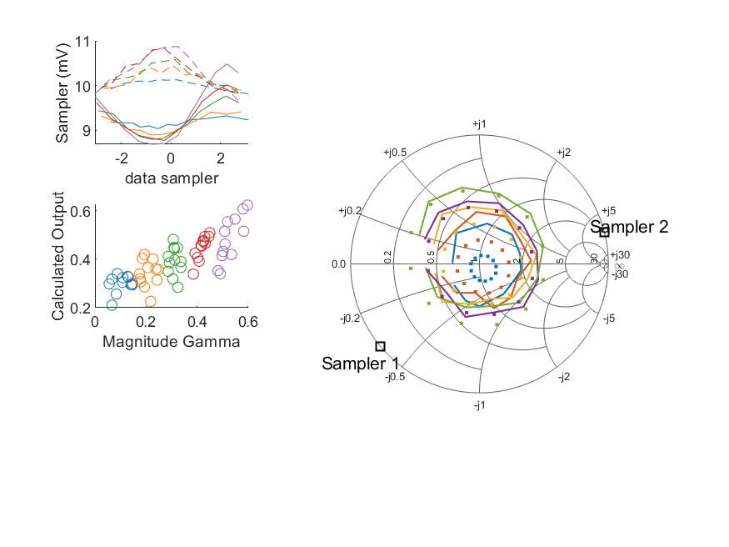
Coupled Line Performance At 11.30 GHz, 16.000000 dBm Output Power 1.00 V mean sampler bias
Sampler Av
Sampler 1: 251.384
Sampler 2: 291.297
Sampler Offset (rather than -1)
-5.1350058650820776
Sampler 1 Range
0.00180
Sampler 2 Range
0.00121
DUT output dBm Mean
16.01902
DUT input dBm Mean
16.52141
RMS Error
0.12590

Slide 15
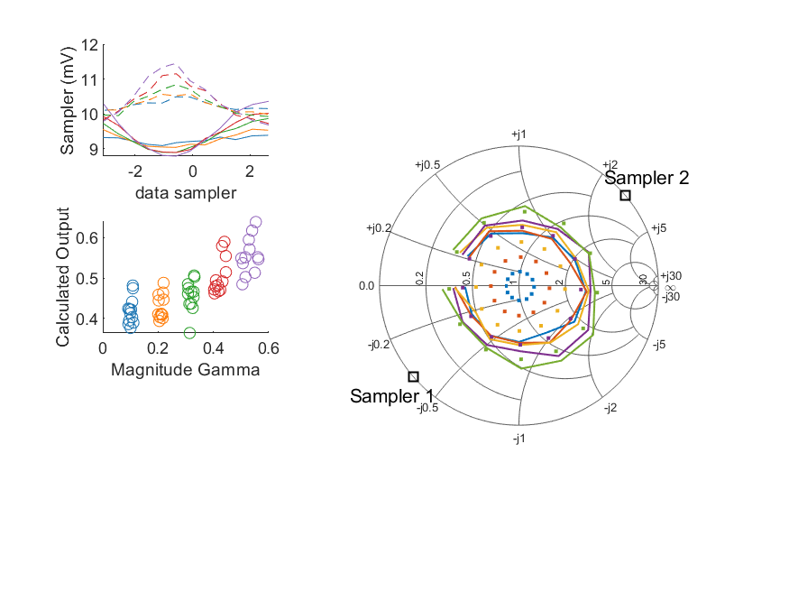
Coupled Line Performance At 11.40 GHz, 16.000000 dBm Output Power 1.00 V mean sampler bias
Sampler Av
Sampler 1: 251.384
Sampler 2: 291.297
Sampler Offset (rather than -1)
-5.1350058650820776
Sampler 1 Range
0.00157
Sampler 2 Range
0.00177
DUT output dBm Mean
16.08653
DUT input dBm Mean
16.59465
RMS Error
0.18981

Slide 16
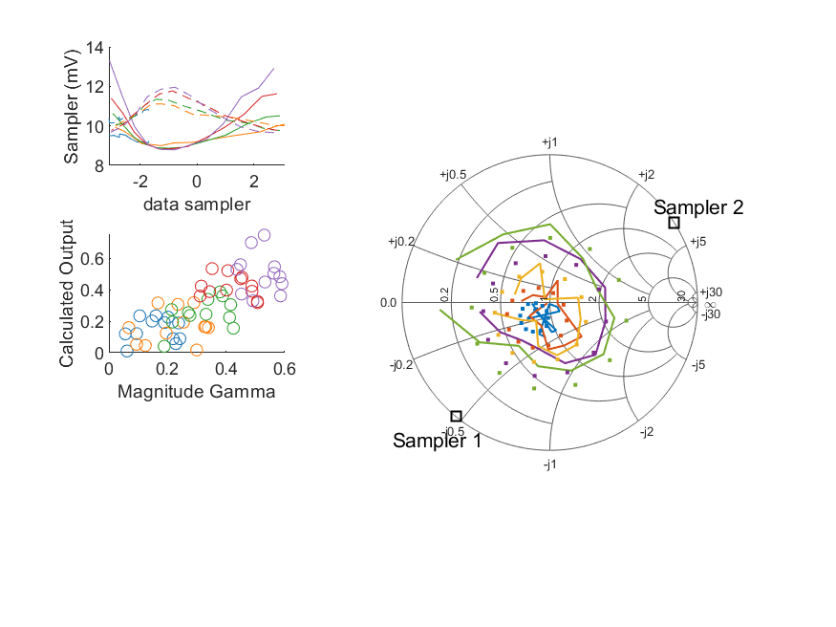
Coupled Line Performance At 10.60 GHz, 18.000000 dBm Output Power 1.00 V mean sampler bias
Sampler Av
Sampler 1: 188.480
Sampler 2: 236.807
Sampler Offset (rather than -1)
-4.2331422830092
Sampler 1 Range
0.00452
Sampler 2 Range
0.00231
DUT output dBm Mean
17.95994
DUT input dBm Mean
18.52291
RMS Error
0.13435

Slide 17
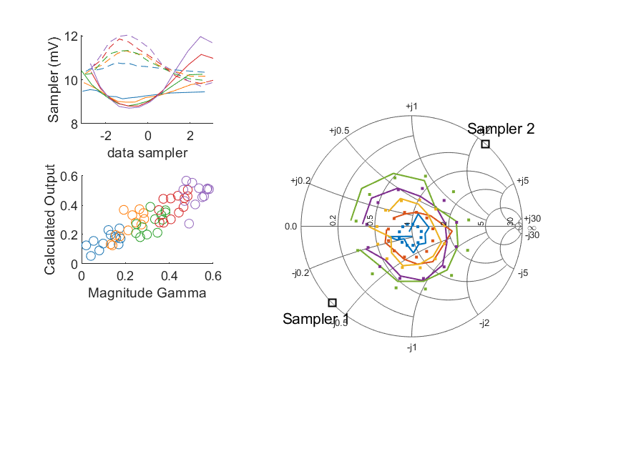
Coupled Line Performance At 10.70 GHz, 18.000000 dBm Output Power 1.00 V mean sampler bias
Sampler Av
Sampler 1: 188.480
Sampler 2: 236.807
Sampler Offset (rather than -1)
-4.2331422830092
Sampler 1 Range
0.00326
Sampler 2 Range
0.00233
DUT output dBm Mean
17.98313
DUT input dBm Mean
18.41311
RMS Error
0.07431

Slide 18
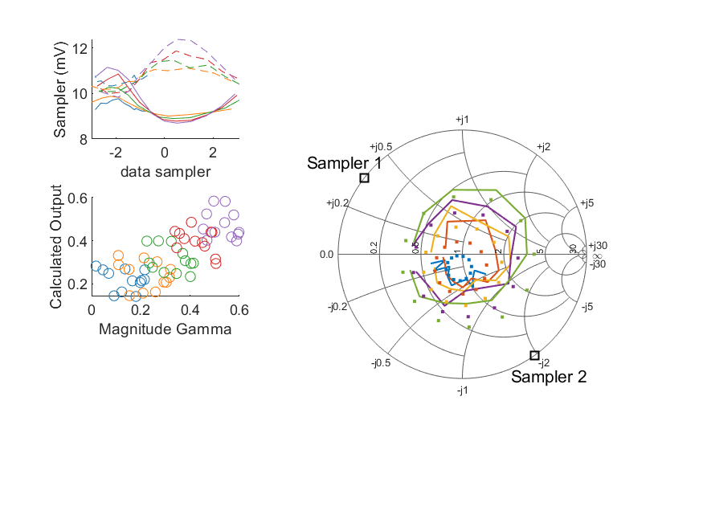
Coupled Line Performance At 10.80 GHz, 18.000000 dBm Output Power 1.00 V mean sampler bias
Sampler Av
Sampler 1: 188.480
Sampler 2: 236.807
Sampler Offset (rather than -1)
-4.2331422830092
Sampler 1 Range
0.00246
Sampler 2 Range
0.00255
DUT output dBm Mean
17.97668
DUT input dBm Mean
18.43052
RMS Error
0.10887

Slide 19
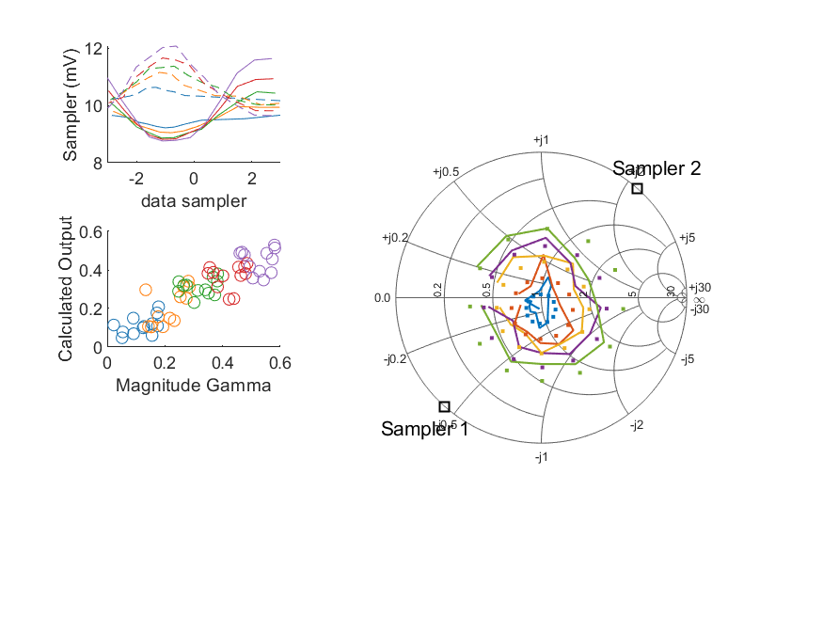
Coupled Line Performance At 10.90 GHz, 18.000000 dBm Output Power 1.00 V mean sampler bias
Sampler Av
Sampler 1: 188.480
Sampler 2: 236.807
Sampler Offset (rather than -1)
-4.2331422830092
Sampler 1 Range
0.00287
Sampler 2 Range
0.00243
DUT output dBm Mean
17.96325
DUT input dBm Mean
18.48621
RMS Error
0.08813

Slide 20
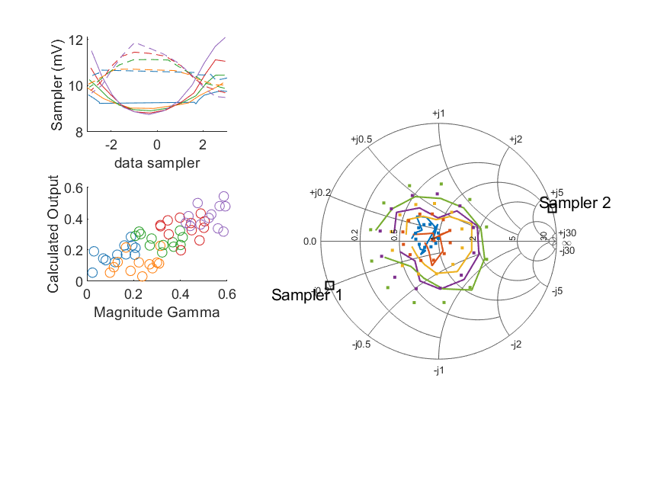
Coupled Line Performance At 11.00 GHz, 18.000000 dBm Output Power 1.00 V mean sampler bias
Sampler Av
Sampler 1: 188.480
Sampler 2: 236.807
Sampler Offset (rather than -1)
-4.2331422830092
Sampler 1 Range
0.00335
Sampler 2 Range
0.00238
DUT output dBm Mean
17.99314
DUT input dBm Mean
18.43569
RMS Error
0.11635

Slide 21
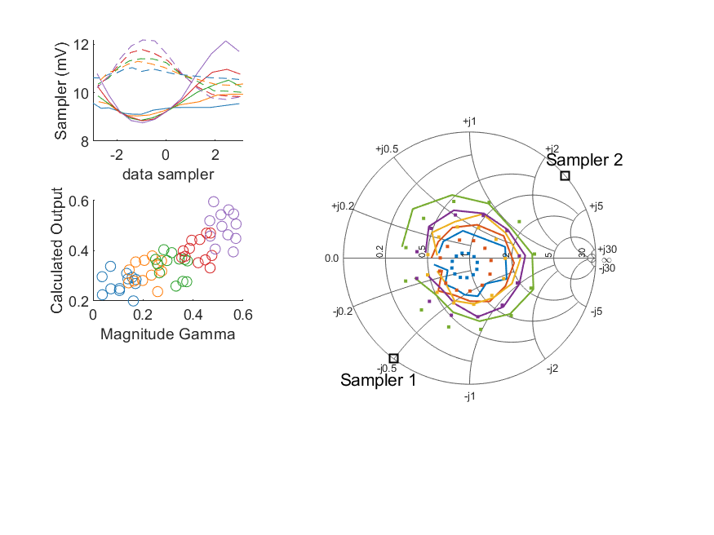
Coupled Line Performance At 11.10 GHz, 18.000000 dBm Output Power 1.00 V mean sampler bias
Sampler Av
Sampler 1: 188.480
Sampler 2: 236.807
Sampler Offset (rather than -1)
-4.2331422830092
Sampler 1 Range
0.00338
Sampler 2 Range
0.00245
DUT output dBm Mean
18.00855
DUT input dBm Mean
18.49477
RMS Error
0.10778

Slide 22
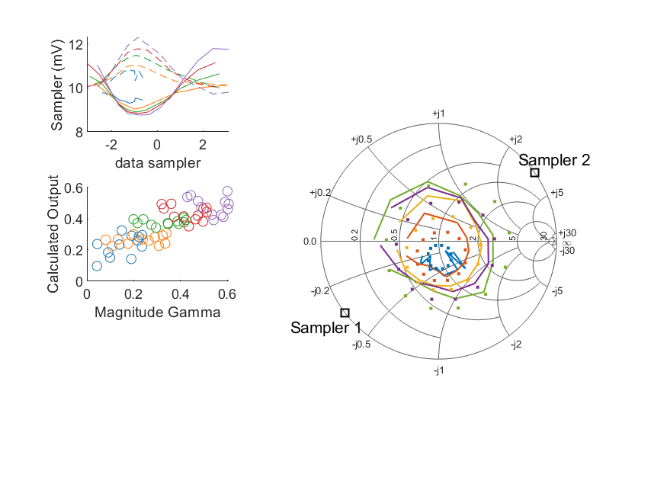
Coupled Line Performance At 11.20 GHz, 18.000000 dBm Output Power 1.00 V mean sampler bias
Sampler Av
Sampler 1: 188.480
Sampler 2: 236.807
Sampler Offset (rather than -1)
-4.2331422830092
Sampler 1 Range
0.00302
Sampler 2 Range
0.00258
DUT output dBm Mean
17.97973
DUT input dBm Mean
18.49973
RMS Error
0.09734

Slide 23
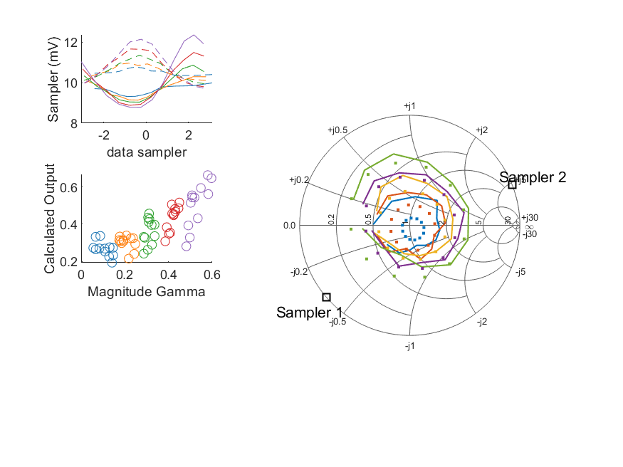
Coupled Line Performance At 11.30 GHz, 18.000000 dBm Output Power 1.00 V mean sampler bias
Sampler Av
Sampler 1: 188.480
Sampler 2: 236.807
Sampler Offset (rather than -1)
-4.2331422830092
Sampler 1 Range
0.00357
Sampler 2 Range
0.00241
DUT output dBm Mean
17.99093
DUT input dBm Mean
18.49604
RMS Error
0.10907

Slide 24
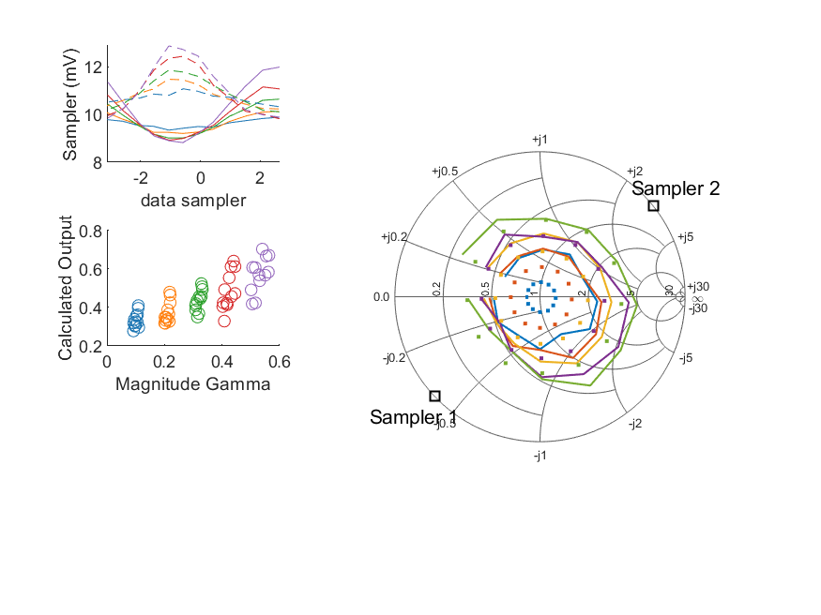
Coupled Line Performance At 11.40 GHz, 18.000000 dBm Output Power 1.00 V mean sampler bias
Sampler Av
Sampler 1: 188.480
Sampler 2: 236.807
Sampler Offset (rather than -1)
-4.2331422830092
Sampler 1 Range
0.00317
Sampler 2 Range
0.00306
DUT output dBm Mean
17.98057
DUT input dBm Mean
18.48904
RMS Error
0.15404

Slide 25
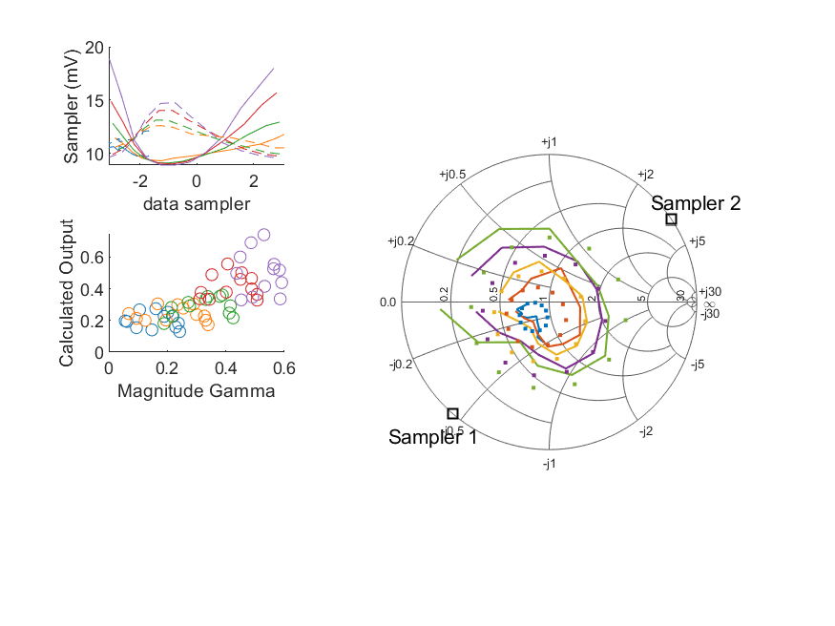
Coupled Line Performance At 10.60 GHz, 20.000000 dBm Output Power 1.00 V mean sampler bias
Sampler Av
Sampler 1: 79.287
Sampler 2: 100.974
Sampler Offset (rather than -1)
-1.9214432552998342
Sampler 1 Range
0.00996
Sampler 2 Range
0.00515
DUT output dBm Mean
19.95554
DUT input dBm Mean
20.52320
RMS Error
0.10758

Slide 26
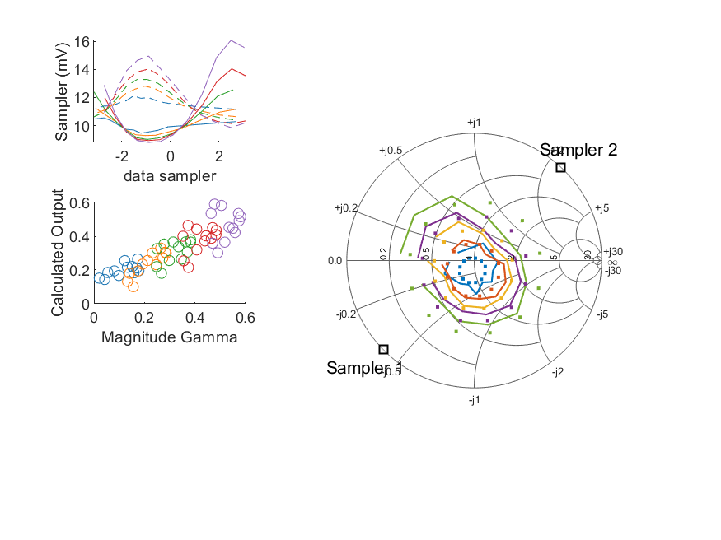
Coupled Line Performance At 10.70 GHz, 20.000000 dBm Output Power 1.00 V mean sampler bias
Sampler Av
Sampler 1: 79.287
Sampler 2: 100.974
Sampler Offset (rather than -1)
-1.9214432552998342
Sampler 1 Range
0.00728
Sampler 2 Range
0.00510
DUT output dBm Mean
19.97484
DUT input dBm Mean
20.41074
RMS Error
0.07917

Slide 27
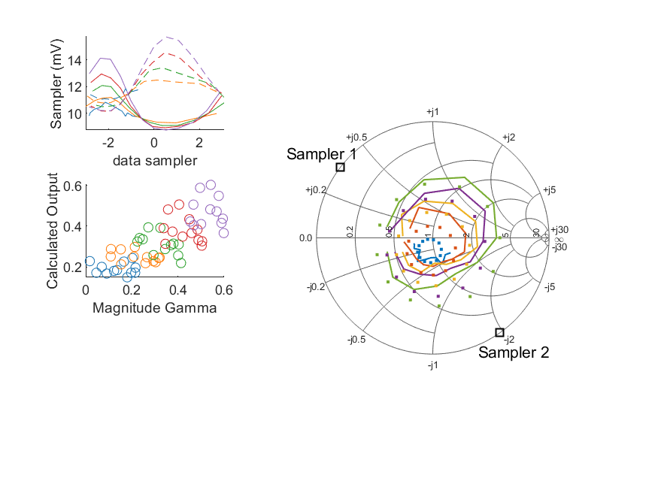
Coupled Line Performance At 10.80 GHz, 20.000000 dBm Output Power 1.00 V mean sampler bias
Sampler Av
Sampler 1: 79.287
Sampler 2: 100.974
Sampler Offset (rather than -1)
-1.9214432552998342
Sampler 1 Range
0.00538
Sampler 2 Range
0.00557
DUT output dBm Mean
19.95833
DUT input dBm Mean
20.41704
RMS Error
0.10261

Slide 28
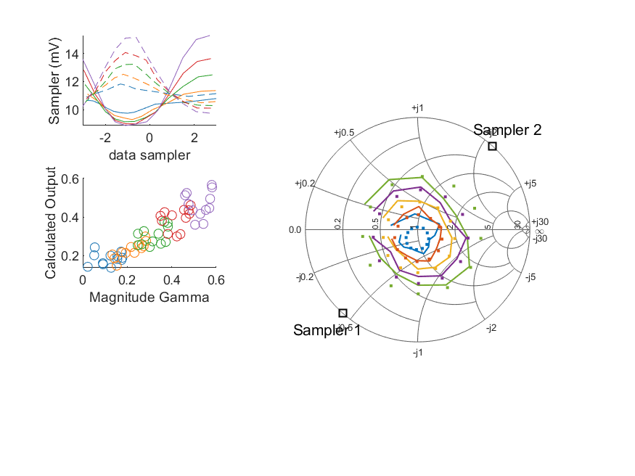
Coupled Line Performance At 10.90 GHz, 20.000000 dBm Output Power 1.00 V mean sampler bias
Sampler Av
Sampler 1: 79.287
Sampler 2: 100.974
Sampler Offset (rather than -1)
-1.9214432552998342
Sampler 1 Range
0.00643
Sampler 2 Range
0.00542
DUT output dBm Mean
19.95208
DUT input dBm Mean
20.47927
RMS Error
0.07081

Slide 29
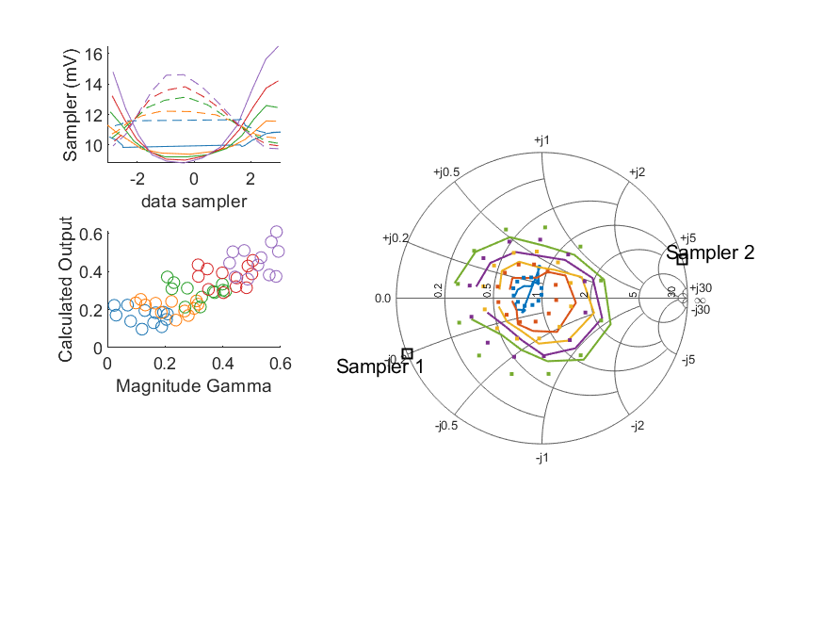
Coupled Line Performance At 11.00 GHz, 20.000000 dBm Output Power 1.00 V mean sampler bias
Sampler Av
Sampler 1: 79.287
Sampler 2: 100.974
Sampler Offset (rather than -1)
-1.9214432552998342
Sampler 1 Range
0.00766
Sampler 2 Range
0.00486
DUT output dBm Mean
19.97735
DUT input dBm Mean
20.42446
RMS Error
0.09432

Slide 30
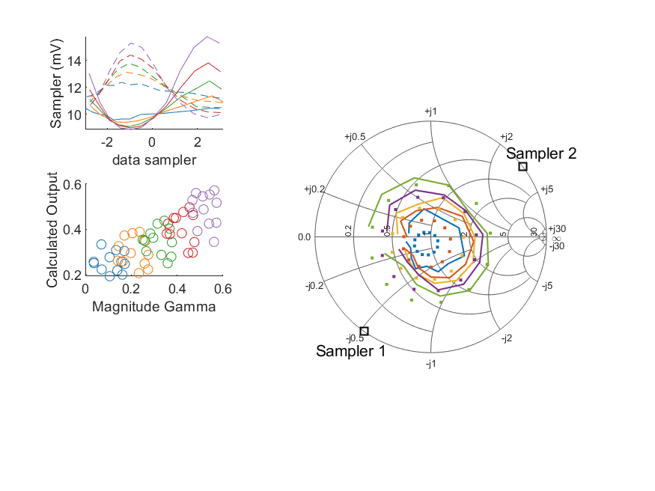
Coupled Line Performance At 11.10 GHz, 20.000000 dBm Output Power 1.00 V mean sampler bias
Sampler Av
Sampler 1: 79.287
Sampler 2: 100.974
Sampler Offset (rather than -1)
-1.9214432552998342
Sampler 1 Range
0.00689
Sampler 2 Range
0.00554
DUT output dBm Mean
19.99462
DUT input dBm Mean
20.48489
RMS Error
0.11095

Slide 31
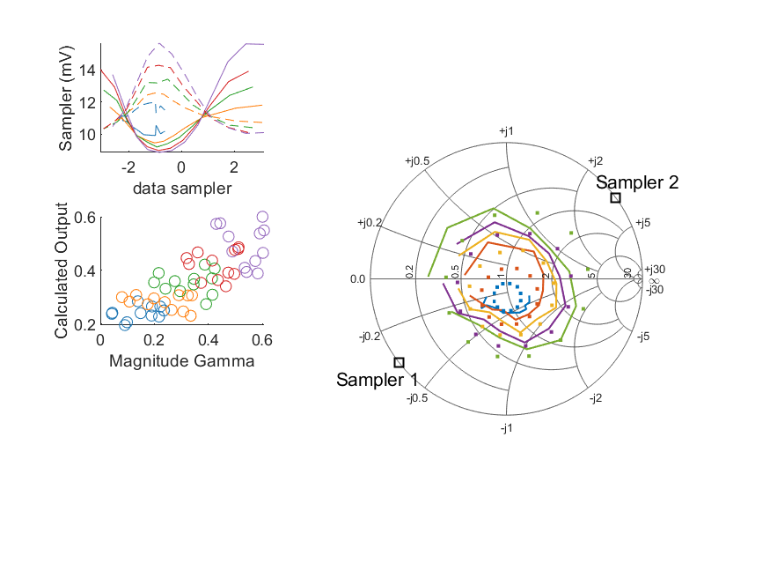
Coupled Line Performance At 11.20 GHz, 20.000000 dBm Output Power 1.00 V mean sampler bias
Sampler Av
Sampler 1: 79.287
Sampler 2: 100.974
Sampler Offset (rather than -1)
-1.9214432552998342
Sampler 1 Range
0.00675
Sampler 2 Range
0.00560
DUT output dBm Mean
19.96828
DUT input dBm Mean
20.49061
RMS Error
0.10215

Slide 32
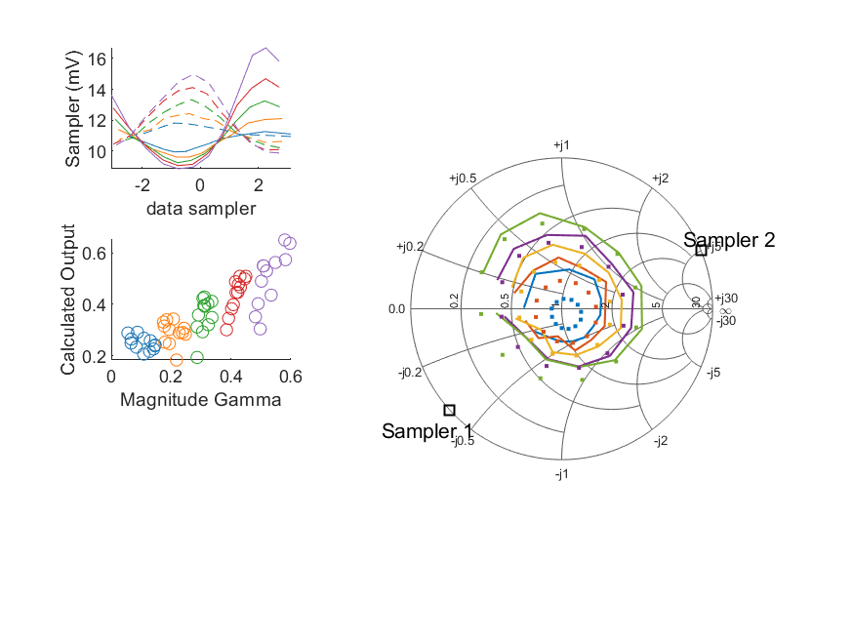
Coupled Line Performance At 11.30 GHz, 20.000000 dBm Output Power 1.00 V mean sampler bias
Sampler Av
Sampler 1: 79.287
Sampler 2: 100.974
Sampler Offset (rather than -1)
-1.9214432552998342
Sampler 1 Range
0.00786
Sampler 2 Range
0.00512
DUT output dBm Mean
19.98845
DUT input dBm Mean
20.49725
RMS Error
0.09829

Slide 33
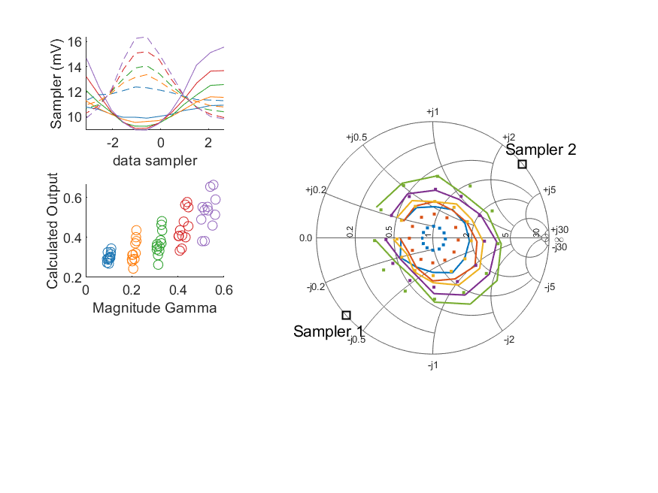
Coupled Line Performance At 11.40 GHz, 20.000000 dBm Output Power 1.00 V mean sampler bias
Sampler Av
Sampler 1: 79.287
Sampler 2: 100.974
Sampler Offset (rather than -1)
-1.9214432552998342
Sampler 1 Range
0.00660
Sampler 2 Range
0.00653
DUT output dBm Mean
19.97018
DUT input dBm Mean
20.47952
RMS Error
0.12158

Slide 34
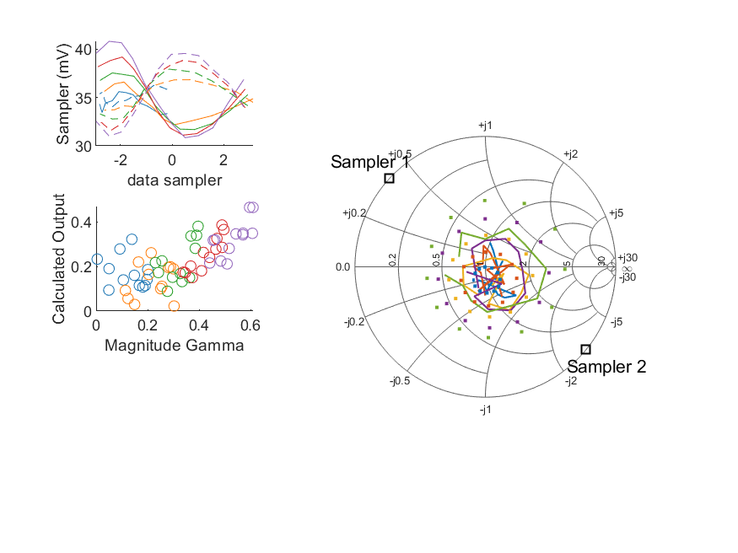
Coupled Line Performance At 10.50 GHz, 12.000000 dBm Output Power 1.25 V mean sampler bias
Sampler Av
Sampler 1: 68.731
Sampler 2: 88.469
Sampler Offset (rather than -1)
-5.496770679221866
Sampler 1 Range
0.00997
Sampler 2 Range
0.00855
DUT output dBm Mean
11.97690
DUT input dBm Mean
12.35384
RMS Error
0.22624

Slide 35
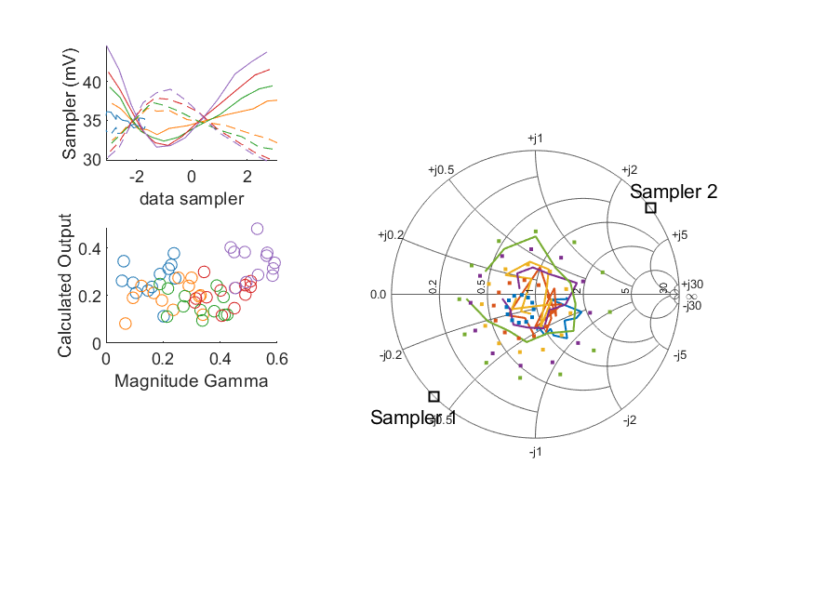
Coupled Line Performance At 10.60 GHz, 12.000000 dBm Output Power 1.25 V mean sampler bias
Sampler Av
Sampler 1: 68.731
Sampler 2: 88.469
Sampler Offset (rather than -1)
-5.496770679221866
Sampler 1 Range
0.01319
Sampler 2 Range
0.00930
DUT output dBm Mean
11.95880
DUT input dBm Mean
12.51334
RMS Error
0.27566

Slide 36
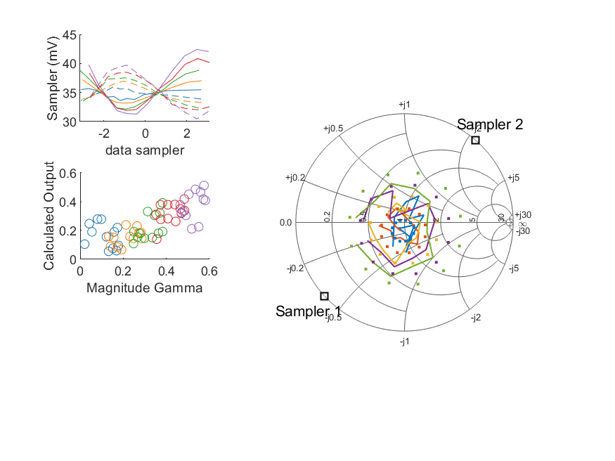
Coupled Line Performance At 10.70 GHz, 12.000000 dBm Output Power 1.25 V mean sampler bias
Sampler Av
Sampler 1: 68.731
Sampler 2: 88.469
Sampler Offset (rather than -1)
-5.496770679221866
Sampler 1 Range
0.01112
Sampler 2 Range
0.00927
DUT output dBm Mean
11.99715
DUT input dBm Mean
12.41888
RMS Error
0.16203

Slide 37
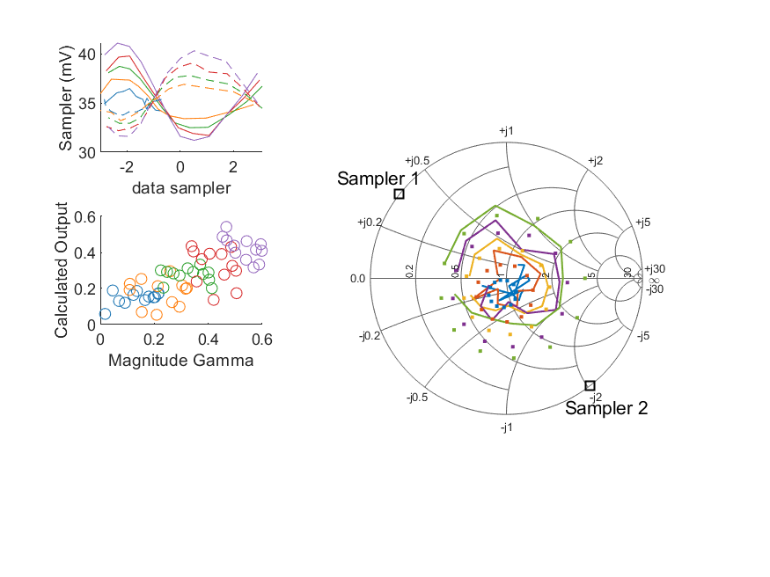
Coupled Line Performance At 10.80 GHz, 12.000000 dBm Output Power 1.25 V mean sampler bias
Sampler Av
Sampler 1: 68.731
Sampler 2: 88.469
Sampler Offset (rather than -1)
-5.496770679221866
Sampler 1 Range
0.00989
Sampler 2 Range
0.00871
DUT output dBm Mean
11.97586
DUT input dBm Mean
12.42022
RMS Error
0.14604

Slide 38
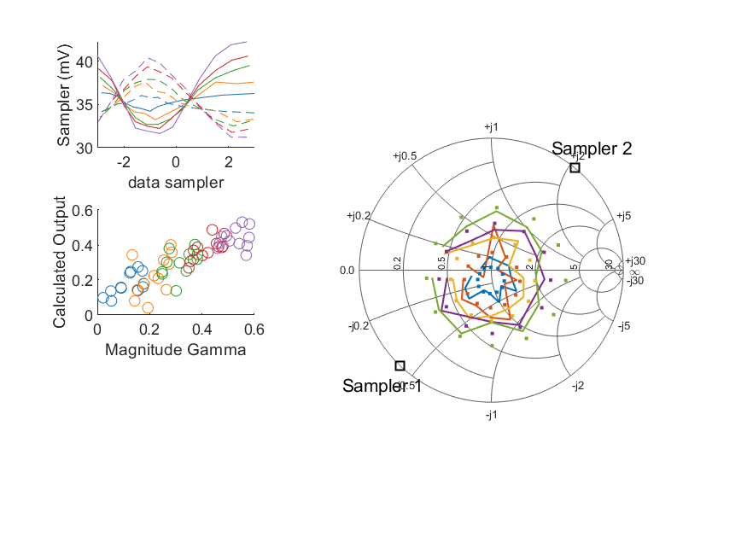
Coupled Line Performance At 10.90 GHz, 12.000000 dBm Output Power 1.25 V mean sampler bias
Sampler Av
Sampler 1: 68.731
Sampler 2: 88.469
Sampler Offset (rather than -1)
-5.496770679221866
Sampler 1 Range
0.01060
Sampler 2 Range
0.00918
DUT output dBm Mean
11.96901
DUT input dBm Mean
12.48683
RMS Error
0.08614

Slide 39
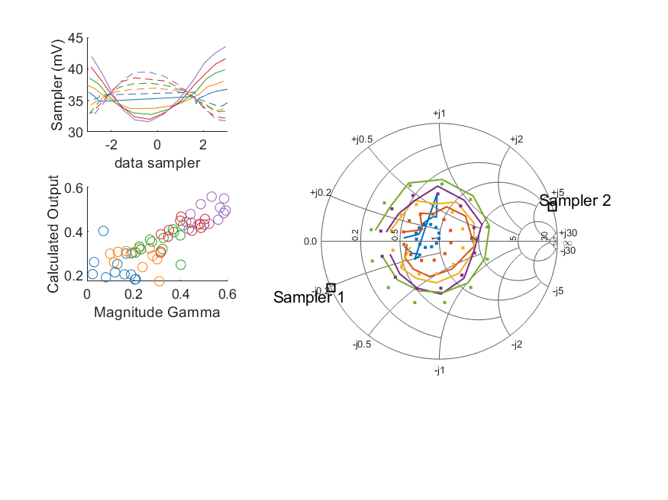
Coupled Line Performance At 11.00 GHz, 12.000000 dBm Output Power 1.25 V mean sampler bias
Sampler Av
Sampler 1: 68.731
Sampler 2: 88.469
Sampler Offset (rather than -1)
-5.496770679221866
Sampler 1 Range
0.01191
Sampler 2 Range
0.00775
DUT output dBm Mean
11.99300
DUT input dBm Mean
12.42804
RMS Error
0.09803

Slide 40
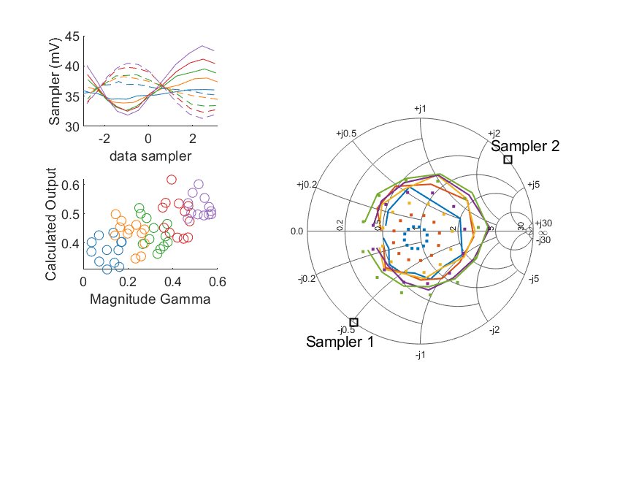
Coupled Line Performance At 11.10 GHz, 12.000000 dBm Output Power 1.25 V mean sampler bias
Sampler Av
Sampler 1: 68.731
Sampler 2: 88.469
Sampler Offset (rather than -1)
-5.496770679221866
Sampler 1 Range
0.01148
Sampler 2 Range
0.00916
DUT output dBm Mean
12.01753
DUT input dBm Mean
12.50236
RMS Error
0.17896

Slide 41
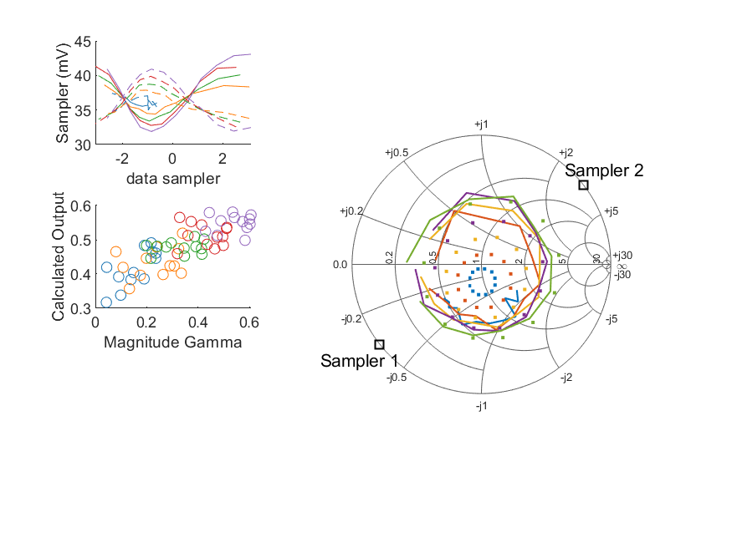
Coupled Line Performance At 11.20 GHz, 12.000000 dBm Output Power 1.25 V mean sampler bias
Sampler Av
Sampler 1: 68.731
Sampler 2: 88.469
Sampler Offset (rather than -1)
-5.496770679221866
Sampler 1 Range
0.01119
Sampler 2 Range
0.00896
DUT output dBm Mean
11.99410
DUT input dBm Mean
12.50507
RMS Error
0.18037

Slide 42
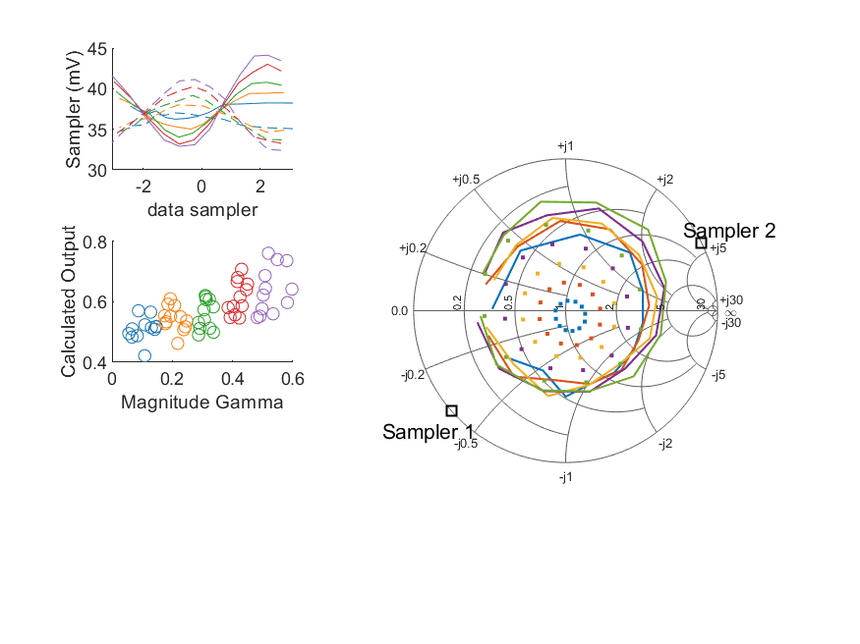
Coupled Line Performance At 11.30 GHz, 12.000000 dBm Output Power 1.25 V mean sampler bias
Sampler Av
Sampler 1: 68.731
Sampler 2: 88.469
Sampler Offset (rather than -1)
-5.496770679221866
Sampler 1 Range
0.01123
Sampler 2 Range
0.00872
DUT output dBm Mean
12.00444
DUT input dBm Mean
12.50373
RMS Error
0.28383

Slide 43
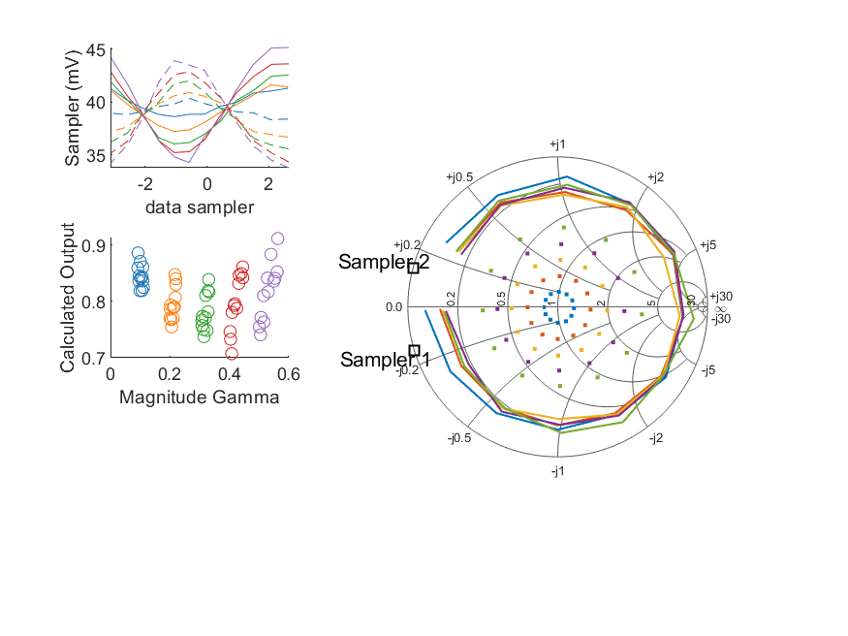
Coupled Line Performance At 11.40 GHz, 12.000000 dBm Output Power 1.25 V mean sampler bias
Sampler Av
Sampler 1: 68.731
Sampler 2: 88.469
Sampler Offset (rather than -1)
-5.496770679221866
Sampler 1 Range
0.01088
Sampler 2 Range
0.01013
DUT output dBm Mean
11.99206
DUT input dBm Mean
12.49232
RMS Error
0.51665

Slide 44
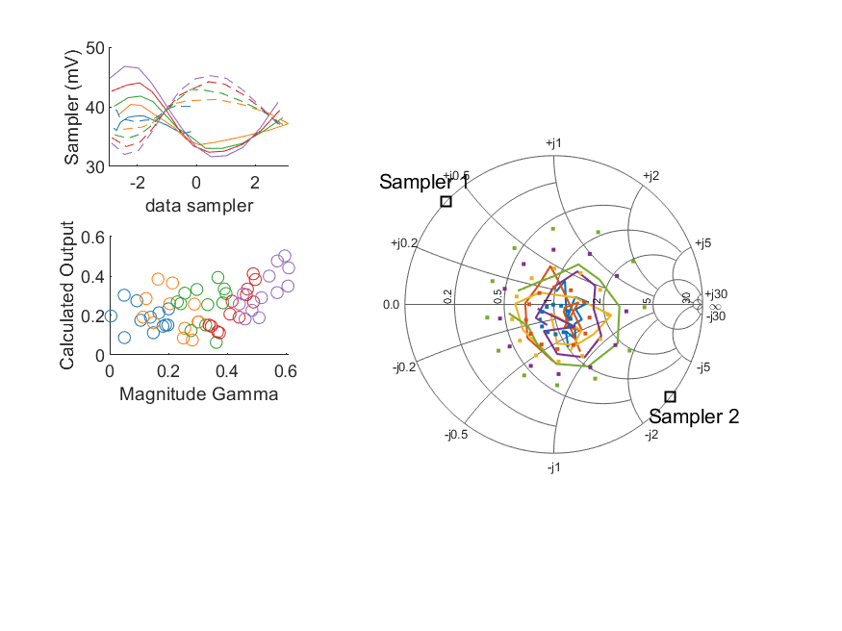
Coupled Line Performance At 10.50 GHz, 14.000000 dBm Output Power 1.25 V mean sampler bias
Sampler Av
Sampler 1: 61.531
Sampler 2: 76.052
Sampler Offset (rather than -1)
-5.2607045463281192
Sampler 1 Range
0.01516
Sampler 2 Range
0.01319
DUT output dBm Mean
13.93180
DUT input dBm Mean
14.31061
RMS Error
0.25969

Slide 45
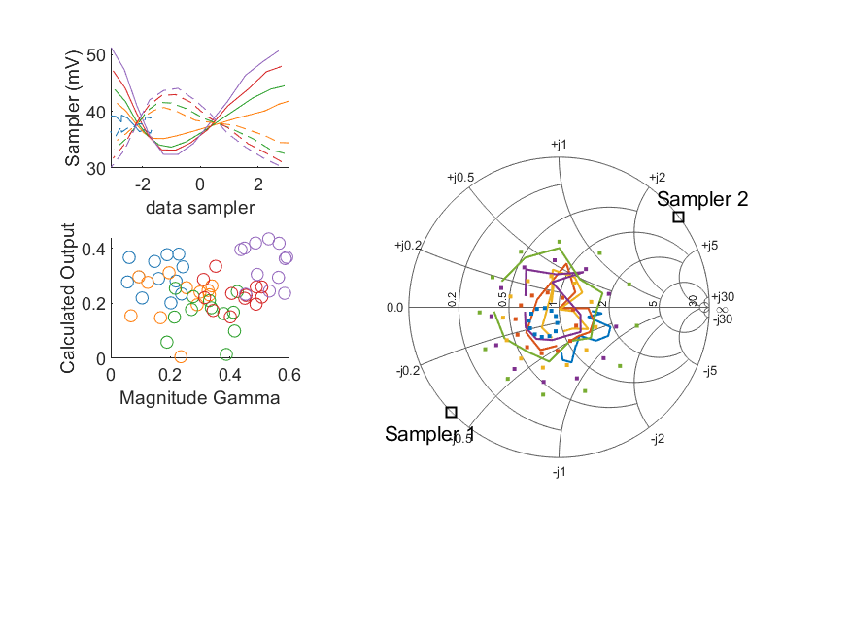
Coupled Line Performance At 10.60 GHz, 14.000000 dBm Output Power 1.25 V mean sampler bias
Sampler Av
Sampler 1: 61.531
Sampler 2: 76.052
Sampler Offset (rather than -1)
-5.2607045463281192
Sampler 1 Range
0.01887
Sampler 2 Range
0.01393
DUT output dBm Mean
13.91625
DUT input dBm Mean
14.47170
RMS Error
0.30574

Slide 46
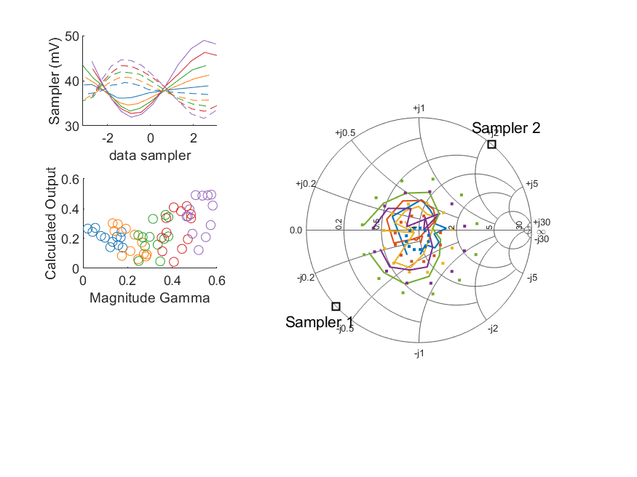
Coupled Line Performance At 10.70 GHz, 14.000000 dBm Output Power 1.25 V mean sampler bias
Sampler Av
Sampler 1: 61.531
Sampler 2: 76.052
Sampler Offset (rather than -1)
-5.2607045463281192
Sampler 1 Range
0.01704
Sampler 2 Range
0.01302
DUT output dBm Mean
13.94898
DUT input dBm Mean
14.37143
RMS Error
0.24712

Slide 47
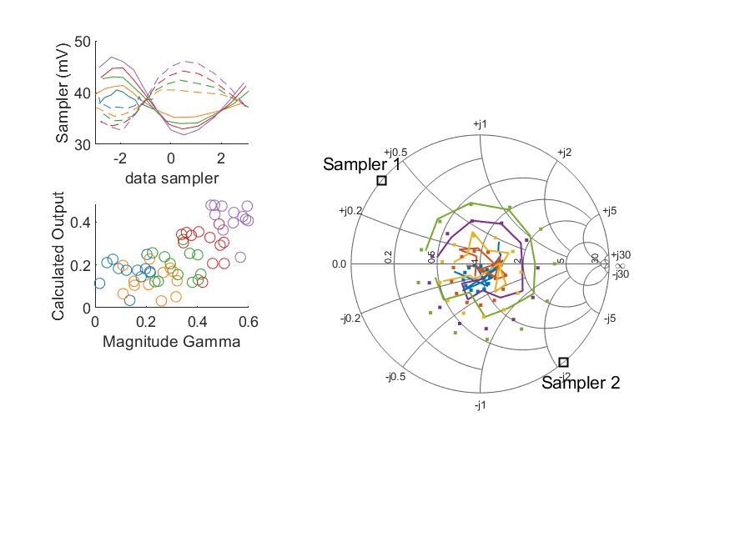
Coupled Line Performance At 10.80 GHz, 14.000000 dBm Output Power 1.25 V mean sampler bias
Sampler Av
Sampler 1: 61.531
Sampler 2: 76.052
Sampler Offset (rather than -1)
-5.2607045463281192
Sampler 1 Range
0.01507
Sampler 2 Range
0.01338
DUT output dBm Mean
13.93549
DUT input dBm Mean
14.38026
RMS Error
0.19326

Slide 48
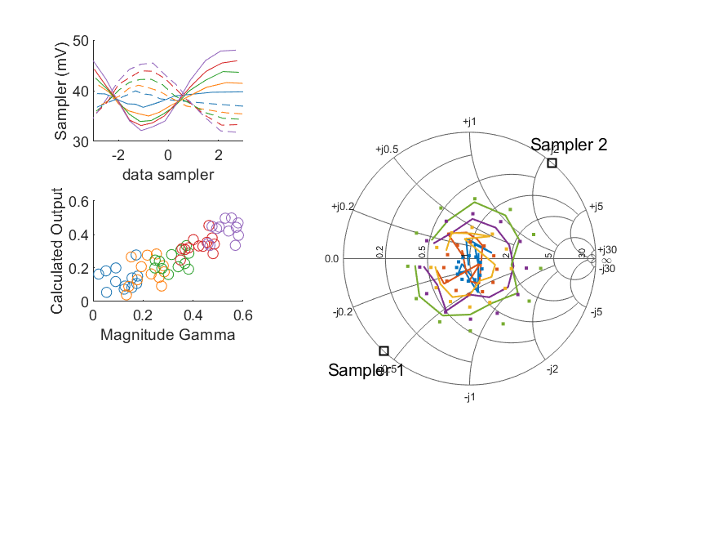
Coupled Line Performance At 10.90 GHz, 14.000000 dBm Output Power 1.25 V mean sampler bias
Sampler Av
Sampler 1: 61.531
Sampler 2: 76.052
Sampler Offset (rather than -1)
-5.2607045463281192
Sampler 1 Range
0.01588
Sampler 2 Range
0.01364
DUT output dBm Mean
13.92341
DUT input dBm Mean
14.44060
RMS Error
0.14090

Slide 49
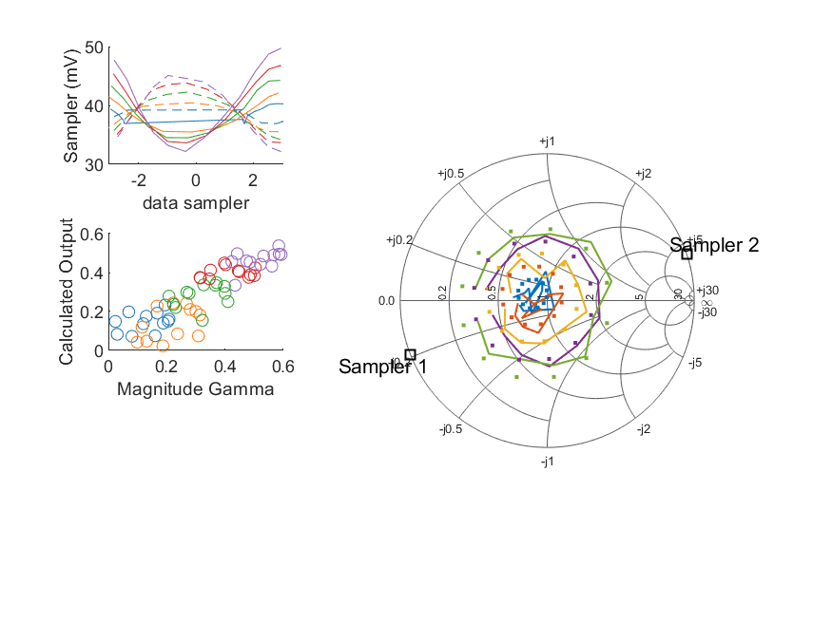
Coupled Line Performance At 11.00 GHz, 14.000000 dBm Output Power 1.25 V mean sampler bias
Sampler Av
Sampler 1: 61.531
Sampler 2: 76.052
Sampler Offset (rather than -1)
-5.2607045463281192
Sampler 1 Range
0.01754
Sampler 2 Range
0.01292
DUT output dBm Mean
13.95098
DUT input dBm Mean
14.38547
RMS Error
0.11004

Slide 50
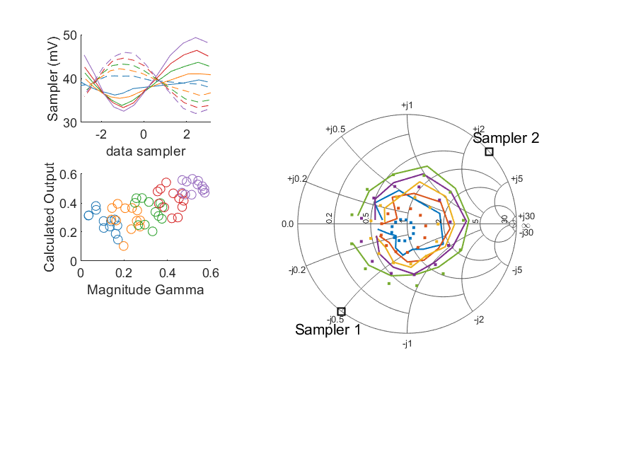
Coupled Line Performance At 11.10 GHz, 14.000000 dBm Output Power 1.25 V mean sampler bias
Sampler Av
Sampler 1: 61.531
Sampler 2: 76.052
Sampler Offset (rather than -1)
-5.2607045463281192
Sampler 1 Range
0.01680
Sampler 2 Range
0.01397
DUT output dBm Mean
13.97130
DUT input dBm Mean
14.45605
RMS Error
0.12121

Slide 51
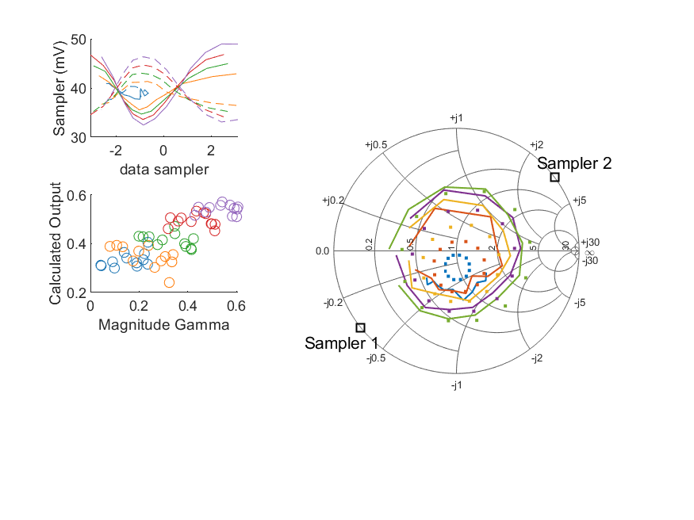
Coupled Line Performance At 11.20 GHz, 14.000000 dBm Output Power 1.25 V mean sampler bias
Sampler Av
Sampler 1: 61.531
Sampler 2: 76.052
Sampler Offset (rather than -1)
-5.2607045463281192
Sampler 1 Range
0.01649
Sampler 2 Range
0.01326
DUT output dBm Mean
13.94430
DUT input dBm Mean
14.45486
RMS Error
0.13598

Slide 52

Coupled Line Performance At 11.30 GHz, 14.000000 dBm Output Power 1.25 V mean sampler bias
Sampler Av
Sampler 1: 61.531
Sampler 2: 76.052
Sampler Offset (rather than -1)
-5.2607045463281192
Sampler 1 Range
0.01708
Sampler 2 Range
0.01275
DUT output dBm Mean
13.96108
DUT input dBm Mean
14.45967
RMS Error
0.22919

Slide 53

Coupled Line Performance At 11.40 GHz, 14.000000 dBm Output Power 1.25 V mean sampler bias
Sampler Av
Sampler 1: 61.531
Sampler 2: 76.052
Sampler Offset (rather than -1)
-5.2607045463281192
Sampler 1 Range
0.01575
Sampler 2 Range
0.01485
DUT output dBm Mean
13.94967
DUT input dBm Mean
14.44990
RMS Error
0.35606

Slide 54

Coupled Line Performance At 10.50 GHz, 16.000000 dBm Output Power 1.25 V mean sampler bias
Sampler Av
Sampler 1: 45.054
Sampler 2: 54.537
Sampler Offset (rather than -1)
-4.2354765589518353
Sampler 1 Range
0.02246
Sampler 2 Range
0.01964
DUT output dBm Mean
15.89143
DUT input dBm Mean
16.27347
RMS Error
0.17480

Slide 55

Coupled Line Performance At 10.60 GHz, 16.000000 dBm Output Power 1.25 V mean sampler bias
Sampler Av
Sampler 1: 45.054
Sampler 2: 54.537
Sampler Offset (rather than -1)
-4.2354765589518353
Sampler 1 Range
0.02863
Sampler 2 Range
0.02033
DUT output dBm Mean
15.88481
DUT input dBm Mean
16.44211
RMS Error
0.24107

Slide 56

Coupled Line Performance At 10.70 GHz, 16.000000 dBm Output Power 1.25 V mean sampler bias
Sampler Av
Sampler 1: 45.054
Sampler 2: 54.537
Sampler Offset (rather than -1)
-4.2354765589518353
Sampler 1 Range
0.02490
Sampler 2 Range
0.01978
DUT output dBm Mean
15.91656
DUT input dBm Mean
16.34040
RMS Error
0.20642

Slide 57

Coupled Line Performance At 10.80 GHz, 16.000000 dBm Output Power 1.25 V mean sampler bias
Sampler Av
Sampler 1: 45.054
Sampler 2: 54.537
Sampler Offset (rather than -1)
-4.2354765589518353
Sampler 1 Range
0.02176
Sampler 2 Range
0.01962
DUT output dBm Mean
15.89489
DUT input dBm Mean
16.34168
RMS Error
0.14686

Slide 58

Coupled Line Performance At 10.90 GHz, 16.000000 dBm Output Power 1.25 V mean sampler bias
Sampler Av
Sampler 1: 45.054
Sampler 2: 54.537
Sampler Offset (rather than -1)
-4.2354765589518353
Sampler 1 Range
0.02367
Sampler 2 Range
0.02011
DUT output dBm Mean
15.88941
DUT input dBm Mean
16.40747
RMS Error
0.08502

Slide 59

Coupled Line Performance At 11.00 GHz, 16.000000 dBm Output Power 1.25 V mean sampler bias
Sampler Av
Sampler 1: 45.054
Sampler 2: 54.537
Sampler Offset (rather than -1)
-4.2354765589518353
Sampler 1 Range
0.02547
Sampler 2 Range
0.01868
DUT output dBm Mean
15.91192
DUT input dBm Mean
16.34808
RMS Error
0.06754

Slide 60

Coupled Line Performance At 11.10 GHz, 16.000000 dBm Output Power 1.25 V mean sampler bias
Sampler Av
Sampler 1: 45.054
Sampler 2: 54.537
Sampler Offset (rather than -1)
-4.2354765589518353
Sampler 1 Range
0.02432
Sampler 2 Range
0.02143
DUT output dBm Mean
15.94221
DUT input dBm Mean
16.42825
RMS Error
0.12521

Slide 61

Coupled Line Performance At 11.20 GHz, 16.000000 dBm Output Power 1.25 V mean sampler bias
Sampler Av
Sampler 1: 45.054
Sampler 2: 54.537
Sampler Offset (rather than -1)
-4.2354765589518353
Sampler 1 Range
0.02448
Sampler 2 Range
0.01989
DUT output dBm Mean
15.90423
DUT input dBm Mean
16.41613
RMS Error
0.12946

Slide 62

Coupled Line Performance At 11.30 GHz, 16.000000 dBm Output Power 1.25 V mean sampler bias
Sampler Av
Sampler 1: 45.054
Sampler 2: 54.537
Sampler Offset (rather than -1)
-4.2354765589518353
Sampler 1 Range
0.02582
Sampler 2 Range
0.01947
DUT output dBm Mean
15.93590
DUT input dBm Mean
16.43511
RMS Error
0.23540

Slide 63

Coupled Line Performance At 11.40 GHz, 16.000000 dBm Output Power 1.25 V mean sampler bias
Sampler Av
Sampler 1: 45.054
Sampler 2: 54.537
Sampler Offset (rather than -1)
-4.2354765589518353
Sampler 1 Range
0.02300
Sampler 2 Range
0.02260
DUT output dBm Mean
15.90804
DUT input dBm Mean
16.40901
RMS Error
0.25733

Slide 64

Coupled Line Performance At 10.50 GHz, 8.000000 dBm Output Power 1.50 V mean sampler bias
Sampler Av
Sampler 1: 103.374
Sampler 2: 117.212
Sampler Offset (rather than -1)
-29.199071382521861
Sampler 1 Range
0.00740
Sampler 2 Range
0.00726
DUT output dBm Mean
7.98123
DUT input dBm Mean
8.35573
RMS Error
0.45121

Slide 65

Coupled Line Performance At 10.60 GHz, 8.000000 dBm Output Power 1.50 V mean sampler bias
Sampler Av
Sampler 1: 103.374
Sampler 2: 117.212
Sampler Offset (rather than -1)
-29.199071382521861
Sampler 1 Range
0.00946
Sampler 2 Range
0.00749
DUT output dBm Mean
7.96929
DUT input dBm Mean
8.52157
RMS Error
0.42534

Slide 66

Coupled Line Performance At 10.70 GHz, 8.000000 dBm Output Power 1.50 V mean sampler bias
Sampler Av
Sampler 1: 103.374
Sampler 2: 117.212
Sampler Offset (rather than -1)
-29.199071382521861
Sampler 1 Range
0.00821
Sampler 2 Range
0.00731
DUT output dBm Mean
8.00383
DUT input dBm Mean
8.42507
RMS Error
0.33000

Slide 67

Coupled Line Performance At 10.80 GHz, 8.000000 dBm Output Power 1.50 V mean sampler bias
Sampler Av
Sampler 1: 103.374
Sampler 2: 117.212
Sampler Offset (rather than -1)
-29.199071382521861
Sampler 1 Range
0.00734
Sampler 2 Range
0.00718
DUT output dBm Mean
7.98583
DUT input dBm Mean
8.42928
RMS Error
0.21788

Slide 68

Coupled Line Performance At 10.90 GHz, 8.000000 dBm Output Power 1.50 V mean sampler bias
Sampler Av
Sampler 1: 103.374
Sampler 2: 117.212
Sampler Offset (rather than -1)
-29.199071382521861
Sampler 1 Range
0.00781
Sampler 2 Range
0.00729
DUT output dBm Mean
7.98851
DUT input dBm Mean
8.50248
RMS Error
0.09236

Slide 69

Coupled Line Performance At 11.00 GHz, 8.000000 dBm Output Power 1.50 V mean sampler bias
Sampler Av
Sampler 1: 103.374
Sampler 2: 117.212
Sampler Offset (rather than -1)
-29.199071382521861
Sampler 1 Range
0.00851
Sampler 2 Range
0.00666
DUT output dBm Mean
8.00101
DUT input dBm Mean
8.43453
RMS Error
0.12505

Slide 70

Coupled Line Performance At 11.10 GHz, 8.000000 dBm Output Power 1.50 V mean sampler bias
Sampler Av
Sampler 1: 103.374
Sampler 2: 117.212
Sampler Offset (rather than -1)
-29.199071382521861
Sampler 1 Range
0.00819
Sampler 2 Range
0.00761
DUT output dBm Mean
8.02406
DUT input dBm Mean
8.50690
RMS Error
0.22624

Slide 71

Coupled Line Performance At 11.20 GHz, 8.000000 dBm Output Power 1.50 V mean sampler bias
Sampler Av
Sampler 1: 103.374
Sampler 2: 117.212
Sampler Offset (rather than -1)
-29.199071382521861
Sampler 1 Range
0.00828
Sampler 2 Range
0.00718
DUT output dBm Mean
8.00285
DUT input dBm Mean
8.51427
RMS Error
0.28222

Slide 72

Coupled Line Performance At 11.30 GHz, 8.000000 dBm Output Power 1.50 V mean sampler bias
Sampler Av
Sampler 1: 103.374
Sampler 2: 117.212
Sampler Offset (rather than -1)
-29.199071382521861
Sampler 1 Range
0.00843
Sampler 2 Range
0.00716
DUT output dBm Mean
8.02025
DUT input dBm Mean
8.51770
RMS Error
0.40564

Slide 73

Coupled Line Performance At 11.40 GHz, 8.000000 dBm Output Power 1.50 V mean sampler bias
Sampler Av
Sampler 1: 103.374
Sampler 2: 117.212
Sampler Offset (rather than -1)
-29.199071382521861
Sampler 1 Range
0.00783
Sampler 2 Range
0.00797
DUT output dBm Mean
7.99605
DUT input dBm Mean
8.49604
RMS Error
0.65579

Slide 74

Coupled Line Performance At 10.50 GHz, 10.000000 dBm Output Power 1.50 V mean sampler bias
Sampler Av
Sampler 1: 95.311
Sampler 2: 105.856
Sampler Offset (rather than -1)
-27.175312323396845
Sampler 1 Range
0.01116
Sampler 2 Range
0.01093
DUT output dBm Mean
9.97418
DUT input dBm Mean
10.35095
RMS Error
0.47785

Slide 75

Coupled Line Performance At 10.60 GHz, 10.000000 dBm Output Power 1.50 V mean sampler bias
Sampler Av
Sampler 1: 95.311
Sampler 2: 105.856
Sampler Offset (rather than -1)
-27.175312323396845
Sampler 1 Range
0.01410
Sampler 2 Range
0.01141
DUT output dBm Mean
9.96974
DUT input dBm Mean
10.52382
RMS Error
0.46585

Slide 76

Coupled Line Performance At 10.70 GHz, 10.000000 dBm Output Power 1.50 V mean sampler bias
Sampler Av
Sampler 1: 95.311
Sampler 2: 105.856
Sampler Offset (rather than -1)
-27.175312323396845
Sampler 1 Range
0.01243
Sampler 2 Range
0.01089
DUT output dBm Mean
10.00731
DUT input dBm Mean
10.42920
RMS Error
0.37729

Slide 77

Coupled Line Performance At 10.80 GHz, 10.000000 dBm Output Power 1.50 V mean sampler bias
Sampler Av
Sampler 1: 95.311
Sampler 2: 105.856
Sampler Offset (rather than -1)
-27.175312323396845
Sampler 1 Range
0.01079
Sampler 2 Range
0.01080
DUT output dBm Mean
9.98344
DUT input dBm Mean
10.42717
RMS Error
0.32829

Slide 78

Coupled Line Performance At 10.90 GHz, 10.000000 dBm Output Power 1.50 V mean sampler bias
Sampler Av
Sampler 1: 95.311
Sampler 2: 105.856
Sampler Offset (rather than -1)
-27.175312323396845
Sampler 1 Range
0.01193
Sampler 2 Range
0.01073
DUT output dBm Mean
9.98551
DUT input dBm Mean
10.50024
RMS Error
0.18287

Slide 79

Coupled Line Performance At 11.00 GHz, 10.000000 dBm Output Power 1.50 V mean sampler bias
Sampler Av
Sampler 1: 95.311
Sampler 2: 105.856
Sampler Offset (rather than -1)
-27.175312323396845
Sampler 1 Range
0.01279
Sampler 2 Range
0.01051
DUT output dBm Mean
10.00471
DUT input dBm Mean
10.43817
RMS Error
0.08827

Slide 80

Coupled Line Performance At 11.10 GHz, 10.000000 dBm Output Power 1.50 V mean sampler bias
Sampler Av
Sampler 1: 95.311
Sampler 2: 105.856
Sampler Offset (rather than -1)
-27.175312323396845
Sampler 1 Range
0.01214
Sampler 2 Range
0.01156
DUT output dBm Mean
10.02668
DUT input dBm Mean
10.51026
RMS Error
0.17756

Slide 81

Coupled Line Performance At 11.20 GHz, 10.000000 dBm Output Power 1.50 V mean sampler bias
Sampler Av
Sampler 1: 95.311
Sampler 2: 105.856
Sampler Offset (rather than -1)
-27.175312323396845
Sampler 1 Range
0.01260
Sampler 2 Range
0.01051
DUT output dBm Mean
9.99443
DUT input dBm Mean
10.50443
RMS Error
0.22502

Slide 82

Coupled Line Performance At 11.30 GHz, 10.000000 dBm Output Power 1.50 V mean sampler bias
Sampler Av
Sampler 1: 95.311
Sampler 2: 105.856
Sampler Offset (rather than -1)
-27.175312323396845
Sampler 1 Range
0.01297
Sampler 2 Range
0.01076
DUT output dBm Mean
10.01223
DUT input dBm Mean
10.50920
RMS Error
0.32657

Slide 83

Coupled Line Performance At 11.40 GHz, 10.000000 dBm Output Power 1.50 V mean sampler bias
Sampler Av
Sampler 1: 95.311
Sampler 2: 105.856
Sampler Offset (rather than -1)
-27.175312323396845
Sampler 1 Range
0.01160
Sampler 2 Range
0.01249
DUT output dBm Mean
10.00137
DUT input dBm Mean
10.50063
RMS Error
0.47749

Slide 84

Coupled Line Performance At 10.50 GHz, 12.000000 dBm Output Power 1.50 V mean sampler bias
Sampler Av
Sampler 1: 66.838
Sampler 2: 74.758
Sampler Offset (rather than -1)
-19.604313427976145
Sampler 1 Range
0.01689
Sampler 2 Range
0.01569
DUT output dBm Mean
11.96207
DUT input dBm Mean
12.34063
RMS Error
0.33514

Slide 85

Coupled Line Performance At 10.60 GHz, 12.000000 dBm Output Power 1.50 V mean sampler bias
Sampler Av
Sampler 1: 66.838
Sampler 2: 74.758
Sampler Offset (rather than -1)
-19.604313427976145
Sampler 1 Range
0.02087
Sampler 2 Range
0.01652
DUT output dBm Mean
11.94602
DUT input dBm Mean
12.50079
RMS Error
0.38422

Slide 86

Coupled Line Performance At 10.70 GHz, 12.000000 dBm Output Power 1.50 V mean sampler bias
Sampler Av
Sampler 1: 66.838
Sampler 2: 74.758
Sampler Offset (rather than -1)
-19.604313427976145
Sampler 1 Range
0.01845
Sampler 2 Range
0.01567
DUT output dBm Mean
11.98740
DUT input dBm Mean
12.41064
RMS Error
0.29648

Slide 87

Coupled Line Performance At 10.80 GHz, 12.000000 dBm Output Power 1.50 V mean sampler bias
Sampler Av
Sampler 1: 66.838
Sampler 2: 74.758
Sampler Offset (rather than -1)
-19.604313427976145
Sampler 1 Range
0.01601
Sampler 2 Range
0.01565
DUT output dBm Mean
11.96507
DUT input dBm Mean
12.41015
RMS Error
0.25415

Slide 88

Coupled Line Performance At 10.90 GHz, 12.000000 dBm Output Power 1.50 V mean sampler bias
Sampler Av
Sampler 1: 66.838
Sampler 2: 74.758
Sampler Offset (rather than -1)
-19.604313427976145
Sampler 1 Range
0.01751
Sampler 2 Range
0.01597
DUT output dBm Mean
11.95689
DUT input dBm Mean
12.47327
RMS Error
0.11895

Slide 89

Coupled Line Performance At 11.00 GHz, 12.000000 dBm Output Power 1.50 V mean sampler bias
Sampler Av
Sampler 1: 66.838
Sampler 2: 74.758
Sampler Offset (rather than -1)
-19.604313427976145
Sampler 1 Range
0.01875
Sampler 2 Range
0.01523
DUT output dBm Mean
11.98064
DUT input dBm Mean
12.41605
RMS Error
0.07321

Slide 90

Coupled Line Performance At 11.10 GHz, 12.000000 dBm Output Power 1.50 V mean sampler bias
Sampler Av
Sampler 1: 66.838
Sampler 2: 74.758
Sampler Offset (rather than -1)
-19.604313427976145
Sampler 1 Range
0.01790
Sampler 2 Range
0.01710
DUT output dBm Mean
12.00341
DUT input dBm Mean
12.48645
RMS Error
0.15007

Slide 91

Coupled Line Performance At 11.20 GHz, 12.000000 dBm Output Power 1.50 V mean sampler bias
Sampler Av
Sampler 1: 66.838
Sampler 2: 74.758
Sampler Offset (rather than -1)
-19.604313427976145
Sampler 1 Range
0.01823
Sampler 2 Range
0.01580
DUT output dBm Mean
11.97671
DUT input dBm Mean
12.48814
RMS Error
0.17994

Slide 92

Coupled Line Performance At 11.30 GHz, 12.000000 dBm Output Power 1.50 V mean sampler bias
Sampler Av
Sampler 1: 66.838
Sampler 2: 74.758
Sampler Offset (rather than -1)
-19.604313427976145
Sampler 1 Range
0.01914
Sampler 2 Range
0.01566
DUT output dBm Mean
11.99106
DUT input dBm Mean
12.48942
RMS Error
0.27460

Slide 93

Coupled Line Performance At 11.40 GHz, 12.000000 dBm Output Power 1.50 V mean sampler bias
Sampler Av
Sampler 1: 66.838
Sampler 2: 74.758
Sampler Offset (rather than -1)
-19.604313427976145
Sampler 1 Range
0.01693
Sampler 2 Range
0.01789
DUT output dBm Mean
11.97512
DUT input dBm Mean
12.47580
RMS Error
0.35274

Slide 94

Coupled Line Performance At 10.50 GHz, 6.000000 dBm Output Power 1.75 V mean sampler bias
Sampler Av
Sampler 1: 184.260
Sampler 2: 203.787
Sampler Offset (rather than -1)
-103.12716682001295
Sampler 1 Range
0.00457
Sampler 2 Range
0.00458
DUT output dBm Mean
5.94375
DUT input dBm Mean
6.31941
RMS Error
0.58531

Slide 95

Coupled Line Performance At 10.60 GHz, 6.000000 dBm Output Power 1.75 V mean sampler bias
Sampler Av
Sampler 1: 184.260
Sampler 2: 203.787
Sampler Offset (rather than -1)
-103.12716682001295
Sampler 1 Range
0.00577
Sampler 2 Range
0.00489
DUT output dBm Mean
5.93941
DUT input dBm Mean
6.48955
RMS Error
0.54966

Slide 96

Coupled Line Performance At 10.70 GHz, 6.000000 dBm Output Power 1.75 V mean sampler bias
Sampler Av
Sampler 1: 184.260
Sampler 2: 203.787
Sampler Offset (rather than -1)
-103.12716682001295
Sampler 1 Range
0.00510
Sampler 2 Range
0.00447
DUT output dBm Mean
5.97181
DUT input dBm Mean
6.38981
RMS Error
0.43886

Slide 97

Coupled Line Performance At 10.80 GHz, 6.000000 dBm Output Power 1.75 V mean sampler bias
Sampler Av
Sampler 1: 184.260
Sampler 2: 203.787
Sampler Offset (rather than -1)
-103.12716682001295
Sampler 1 Range
0.00446
Sampler 2 Range
0.00462
DUT output dBm Mean
5.93947
DUT input dBm Mean
6.38101
RMS Error
0.32764

Slide 98

Coupled Line Performance At 10.90 GHz, 6.000000 dBm Output Power 1.75 V mean sampler bias
Sampler Av
Sampler 1: 184.260
Sampler 2: 203.787
Sampler Offset (rather than -1)
-103.12716682001295
Sampler 1 Range
0.00481
Sampler 2 Range
0.00458
DUT output dBm Mean
5.93986
DUT input dBm Mean
6.45489
RMS Error
0.14458

Slide 99

Coupled Line Performance At 11.00 GHz, 6.000000 dBm Output Power 1.75 V mean sampler bias
Sampler Av
Sampler 1: 184.260
Sampler 2: 203.787
Sampler Offset (rather than -1)
-103.12716682001295
Sampler 1 Range
0.00532
Sampler 2 Range
0.00435
DUT output dBm Mean
5.96874
DUT input dBm Mean
6.40214
RMS Error
0.14639

Slide 100

Coupled Line Performance At 11.10 GHz, 6.000000 dBm Output Power 1.75 V mean sampler bias
Sampler Av
Sampler 1: 184.260
Sampler 2: 203.787
Sampler Offset (rather than -1)
-103.12716682001295
Sampler 1 Range
0.00508
Sampler 2 Range
0.00511
DUT output dBm Mean
5.98880
DUT input dBm Mean
6.47356
RMS Error
0.28778

Slide 101

Coupled Line Performance At 11.20 GHz, 6.000000 dBm Output Power 1.75 V mean sampler bias
Sampler Av
Sampler 1: 184.260
Sampler 2: 203.787
Sampler Offset (rather than -1)
-103.12716682001295
Sampler 1 Range
0.00524
Sampler 2 Range
0.00438
DUT output dBm Mean
5.95643
DUT input dBm Mean
6.46715
RMS Error
0.37822

Slide 102

Coupled Line Performance At 11.30 GHz, 6.000000 dBm Output Power 1.75 V mean sampler bias
Sampler Av
Sampler 1: 184.260
Sampler 2: 203.787
Sampler Offset (rather than -1)
-103.12716682001295
Sampler 1 Range
0.00526
Sampler 2 Range
0.00446
DUT output dBm Mean
5.97898
DUT input dBm Mean
6.47751
RMS Error
0.54457

Slide 103

Coupled Line Performance At 11.40 GHz, 6.000000 dBm Output Power 1.75 V mean sampler bias
Sampler Av
Sampler 1: 184.260
Sampler 2: 203.787
Sampler Offset (rather than -1)
-103.12716682001295
Sampler 1 Range
0.00475
Sampler 2 Range
0.00517
DUT output dBm Mean
5.99573
DUT input dBm Mean
6.49539
RMS Error
0.75548

Slide 104

Coupled Line Performance At 10.50 GHz, 8.000000 dBm Output Power 1.75 V mean sampler bias
Sampler Av
Sampler 1: 149.941
Sampler 2: 162.064
Sampler Offset (rather than -1)
-83.477343674904006
Sampler 1 Range
0.00706
Sampler 2 Range
0.00700
DUT output dBm Mean
7.99725
DUT input dBm Mean
8.37177
RMS Error
0.57456

Slide 105

Coupled Line Performance At 10.60 GHz, 8.000000 dBm Output Power 1.75 V mean sampler bias
Sampler Av
Sampler 1: 149.941
Sampler 2: 162.064
Sampler Offset (rather than -1)
-83.477343674904006
Sampler 1 Range
0.00919
Sampler 2 Range
0.00726
DUT output dBm Mean
7.98371
DUT input dBm Mean
8.53749
RMS Error
0.55993

Slide 106

Coupled Line Performance At 10.70 GHz, 8.000000 dBm Output Power 1.75 V mean sampler bias
Sampler Av
Sampler 1: 149.941
Sampler 2: 162.064
Sampler Offset (rather than -1)
-83.477343674904006
Sampler 1 Range
0.00815
Sampler 2 Range
0.00702
DUT output dBm Mean
8.01736
DUT input dBm Mean
8.43862
RMS Error
0.46010

Slide 107

Coupled Line Performance At 10.80 GHz, 8.000000 dBm Output Power 1.75 V mean sampler bias
Sampler Av
Sampler 1: 149.941
Sampler 2: 162.064
Sampler Offset (rather than -1)
-83.477343674904006
Sampler 1 Range
0.00690
Sampler 2 Range
0.00717
DUT output dBm Mean
8.00390
DUT input dBm Mean
8.44820
RMS Error
0.40864

Slide 108

Coupled Line Performance At 10.90 GHz, 8.000000 dBm Output Power 1.75 V mean sampler bias
Sampler Av
Sampler 1: 149.941
Sampler 2: 162.064
Sampler Offset (rather than -1)
-83.477343674904006
Sampler 1 Range
0.00751
Sampler 2 Range
0.00718
DUT output dBm Mean
7.99271
DUT input dBm Mean
8.50907
RMS Error
0.26600

Slide 109

Coupled Line Performance At 11.00 GHz, 8.000000 dBm Output Power 1.75 V mean sampler bias
Sampler Av
Sampler 1: 149.941
Sampler 2: 162.064
Sampler Offset (rather than -1)
-83.477343674904006
Sampler 1 Range
0.00836
Sampler 2 Range
0.00669
DUT output dBm Mean
8.02451
DUT input dBm Mean
8.45632
RMS Error
0.08575

Slide 110

Coupled Line Performance At 11.10 GHz, 8.000000 dBm Output Power 1.75 V mean sampler bias
Sampler Av
Sampler 1: 149.941
Sampler 2: 162.064
Sampler Offset (rather than -1)
-83.477343674904006
Sampler 1 Range
0.00788
Sampler 2 Range
0.00767
DUT output dBm Mean
8.04555
DUT input dBm Mean
8.52925
RMS Error
0.19854

Slide 111

Coupled Line Performance At 11.20 GHz, 8.000000 dBm Output Power 1.75 V mean sampler bias
Sampler Av
Sampler 1: 149.941
Sampler 2: 162.064
Sampler Offset (rather than -1)
-83.477343674904006
Sampler 1 Range
0.00807
Sampler 2 Range
0.00706
DUT output dBm Mean
8.01509
DUT input dBm Mean
8.52616
RMS Error
0.27659

Slide 112

Coupled Line Performance At 11.30 GHz, 8.000000 dBm Output Power 1.75 V mean sampler bias
Sampler Av
Sampler 1: 149.941
Sampler 2: 162.064
Sampler Offset (rather than -1)
-83.477343674904006
Sampler 1 Range
0.00844
Sampler 2 Range
0.00715
DUT output dBm Mean
8.03851
DUT input dBm Mean
8.53712
RMS Error
0.41260

Slide 113

Coupled Line Performance At 11.40 GHz, 8.000000 dBm Output Power 1.75 V mean sampler bias
Sampler Av
Sampler 1: 149.941
Sampler 2: 162.064
Sampler Offset (rather than -1)
-83.477343674904006
Sampler 1 Range
0.00737
Sampler 2 Range
0.00806
DUT output dBm Mean
8.01077
DUT input dBm Mean
8.51307
RMS Error
0.54548

Slide 114

Coupled Line Performance At 10.50 GHz, 10.000000 dBm Output Power 1.75 V mean sampler bias
Sampler Av
Sampler 1: 99.366
Sampler 2: 108.108
Sampler Offset (rather than -1)
-55.963883021672892
Sampler 1 Range
0.01097
Sampler 2 Range
0.01073
DUT output dBm Mean
9.98103
DUT input dBm Mean
10.35750
RMS Error
0.42959

Slide 115

Coupled Line Performance At 10.60 GHz, 10.000000 dBm Output Power 1.75 V mean sampler bias
Sampler Av
Sampler 1: 99.366
Sampler 2: 108.108
Sampler Offset (rather than -1)
-55.963883021672892
Sampler 1 Range
0.01376
Sampler 2 Range
0.01120
DUT output dBm Mean
9.96800
DUT input dBm Mean
10.52290
RMS Error
0.44464

Slide 116

Coupled Line Performance At 10.70 GHz, 10.000000 dBm Output Power 1.75 V mean sampler bias
Sampler Av
Sampler 1: 99.366
Sampler 2: 108.108
Sampler Offset (rather than -1)
-55.963883021672892
Sampler 1 Range
0.01241
Sampler 2 Range
0.01055
DUT output dBm Mean
10.01058
DUT input dBm Mean
10.43271
RMS Error
0.35843

Slide 117

Coupled Line Performance At 10.80 GHz, 10.000000 dBm Output Power 1.75 V mean sampler bias
Sampler Av
Sampler 1: 99.366
Sampler 2: 108.108
Sampler Offset (rather than -1)
-55.963883021672892
Sampler 1 Range
0.01044
Sampler 2 Range
0.01083
DUT output dBm Mean
9.98928
DUT input dBm Mean
10.43413
RMS Error
0.28594

Slide 118

Coupled Line Performance At 10.90 GHz, 10.000000 dBm Output Power 1.75 V mean sampler bias
Sampler Av
Sampler 1: 99.366
Sampler 2: 108.108
Sampler Offset (rather than -1)
-55.963883021672892
Sampler 1 Range
0.01152
Sampler 2 Range
0.01087
DUT output dBm Mean
9.98905
DUT input dBm Mean
10.50742
RMS Error
0.13228

Slide 119

Coupled Line Performance At 11.00 GHz, 10.000000 dBm Output Power 1.75 V mean sampler bias
Sampler Av
Sampler 1: 99.366
Sampler 2: 108.108
Sampler Offset (rather than -1)
-55.963883021672892
Sampler 1 Range
0.01261
Sampler 2 Range
0.01025
DUT output dBm Mean
10.00211
DUT input dBm Mean
10.43605
RMS Error
0.07101

Slide 120

Coupled Line Performance At 11.10 GHz, 10.000000 dBm Output Power 1.75 V mean sampler bias
Sampler Av
Sampler 1: 99.366
Sampler 2: 108.108
Sampler Offset (rather than -1)
-55.963883021672892
Sampler 1 Range
0.01215
Sampler 2 Range
0.01164
DUT output dBm Mean
10.03628
DUT input dBm Mean
10.52077
RMS Error
0.17357

Slide 121

Coupled Line Performance At 11.20 GHz, 10.000000 dBm Output Power 1.75 V mean sampler bias
Sampler Av
Sampler 1: 99.366
Sampler 2: 108.108
Sampler Offset (rather than -1)
-55.963883021672892
Sampler 1 Range
0.01226
Sampler 2 Range
0.01075
DUT output dBm Mean
9.99775
DUT input dBm Mean
10.50820
RMS Error
0.21303

Slide 122

Coupled Line Performance At 11.30 GHz, 10.000000 dBm Output Power 1.75 V mean sampler bias
Sampler Av
Sampler 1: 99.366
Sampler 2: 108.108
Sampler Offset (rather than -1)
-55.963883021672892
Sampler 1 Range
0.01258
Sampler 2 Range
0.01059
DUT output dBm Mean
10.01442
DUT input dBm Mean
10.51422
RMS Error
0.32070

Slide 123

Coupled Line Performance At 11.40 GHz, 10.000000 dBm Output Power 1.75 V mean sampler bias
Sampler Av
Sampler 1: 99.366
Sampler 2: 108.108
Sampler Offset (rather than -1)
-55.963883021672892
Sampler 1 Range
0.01111
Sampler 2 Range
0.01239
DUT output dBm Mean
10.00646
DUT input dBm Mean
10.50843
RMS Error
0.40303

Slide 124

Coupled Line Performance At 10.50 GHz, 6.000000 dBm Output Power 2.00 V mean sampler bias
Sampler Av
Sampler 1: 225.009
Sampler 2: 244.311
Sampler Offset (rather than -1)
-193.27024119337077
Sampler 1 Range
0.00409
Sampler 2 Range
0.00387
DUT output dBm Mean
5.93448
DUT input dBm Mean
6.30852
RMS Error
0.55647

Slide 125

Coupled Line Performance At 10.60 GHz, 6.000000 dBm Output Power 2.00 V mean sampler bias
Sampler Av
Sampler 1: 225.009
Sampler 2: 244.311
Sampler Offset (rather than -1)
-193.27024119337077
Sampler 1 Range
0.00484
Sampler 2 Range
0.00395
DUT output dBm Mean
5.92832
DUT input dBm Mean
6.48198
RMS Error
0.56867

Slide 126

Coupled Line Performance At 10.70 GHz, 6.000000 dBm Output Power 2.00 V mean sampler bias
Sampler Av
Sampler 1: 225.009
Sampler 2: 244.311
Sampler Offset (rather than -1)
-193.27024119337077
Sampler 1 Range
0.00440
Sampler 2 Range
0.00393
DUT output dBm Mean
5.96225
DUT input dBm Mean
6.38156
RMS Error
0.44625

Slide 127

Coupled Line Performance At 10.80 GHz, 6.000000 dBm Output Power 2.00 V mean sampler bias
Sampler Av
Sampler 1: 225.009
Sampler 2: 244.311
Sampler Offset (rather than -1)
-193.27024119337077
Sampler 1 Range
0.00381
Sampler 2 Range
0.00391
DUT output dBm Mean
5.94172
DUT input dBm Mean
6.38491
RMS Error
0.29926

Slide 128

Coupled Line Performance At 10.90 GHz, 6.000000 dBm Output Power 2.00 V mean sampler bias
Sampler Av
Sampler 1: 225.009
Sampler 2: 244.311
Sampler Offset (rather than -1)
-193.27024119337077
Sampler 1 Range
0.00392
Sampler 2 Range
0.00385
DUT output dBm Mean
5.94583
DUT input dBm Mean
6.45880
RMS Error
0.19669

Slide 129

Coupled Line Performance At 11.00 GHz, 6.000000 dBm Output Power 2.00 V mean sampler bias
Sampler Av
Sampler 1: 225.009
Sampler 2: 244.311
Sampler Offset (rather than -1)
-193.27024119337077
Sampler 1 Range
0.00434
Sampler 2 Range
0.00378
DUT output dBm Mean
5.96663
DUT input dBm Mean
6.39973
RMS Error
0.09044

Slide 130

Coupled Line Performance At 11.10 GHz, 6.000000 dBm Output Power 2.00 V mean sampler bias
Sampler Av
Sampler 1: 225.009
Sampler 2: 244.311
Sampler Offset (rather than -1)
-193.27024119337077
Sampler 1 Range
0.00431
Sampler 2 Range
0.00427
DUT output dBm Mean
5.98428
DUT input dBm Mean
6.46805
RMS Error
0.18567

Slide 131

Coupled Line Performance At 11.20 GHz, 6.000000 dBm Output Power 2.00 V mean sampler bias
Sampler Av
Sampler 1: 225.009
Sampler 2: 244.311
Sampler Offset (rather than -1)
-193.27024119337077
Sampler 1 Range
0.00447
Sampler 2 Range
0.00392
DUT output dBm Mean
5.95755
DUT input dBm Mean
6.46639
RMS Error
0.27380

Slide 132

Coupled Line Performance At 11.30 GHz, 6.000000 dBm Output Power 2.00 V mean sampler bias
Sampler Av
Sampler 1: 225.009
Sampler 2: 244.311
Sampler Offset (rather than -1)
-193.27024119337077
Sampler 1 Range
0.00486
Sampler 2 Range
0.00390
DUT output dBm Mean
5.97269
DUT input dBm Mean
6.46964
RMS Error
0.44098

Slide 133

Coupled Line Performance At 11.40 GHz, 6.000000 dBm Output Power 2.00 V mean sampler bias
Sampler Av
Sampler 1: 225.009
Sampler 2: 244.311
Sampler Offset (rather than -1)
-193.27024119337077
Sampler 1 Range
0.00417
Sampler 2 Range
0.00453
DUT output dBm Mean
5.99217
DUT input dBm Mean
6.49233
RMS Error
0.62896

Slide 134

Coupled Line Performance At 10.50 GHz, 8.000000 dBm Output Power 2.00 V mean sampler bias
Sampler Av
Sampler 1: 161.253
Sampler 2: 173.192
Sampler Offset (rather than -1)
-138.18914518573996
Sampler 1 Range
0.00612
Sampler 2 Range
0.00609
DUT output dBm Mean
8.00790
DUT input dBm Mean
8.38302
RMS Error
0.46337

Slide 135

Coupled Line Performance At 10.60 GHz, 8.000000 dBm Output Power 2.00 V mean sampler bias
Sampler Av
Sampler 1: 161.253
Sampler 2: 173.192
Sampler Offset (rather than -1)
-138.18914518573996
Sampler 1 Range
0.00806
Sampler 2 Range
0.00635
DUT output dBm Mean
7.98379
DUT input dBm Mean
8.53839
RMS Error
0.46705

Slide 136

Coupled Line Performance At 10.70 GHz, 8.000000 dBm Output Power 2.00 V mean sampler bias
Sampler Av
Sampler 1: 161.253
Sampler 2: 173.192
Sampler Offset (rather than -1)
-138.18914518573996
Sampler 1 Range
0.00706
Sampler 2 Range
0.00617
DUT output dBm Mean
8.01450
DUT input dBm Mean
8.43600
RMS Error
0.39410

Slide 137

Coupled Line Performance At 10.80 GHz, 8.000000 dBm Output Power 2.00 V mean sampler bias
Sampler Av
Sampler 1: 161.253
Sampler 2: 173.192
Sampler Offset (rather than -1)
-138.18914518573996
Sampler 1 Range
0.00588
Sampler 2 Range
0.00630
DUT output dBm Mean
8.01046
DUT input dBm Mean
8.45390
RMS Error
0.28007

Slide 138

Coupled Line Performance At 10.90 GHz, 8.000000 dBm Output Power 2.00 V mean sampler bias
Sampler Av
Sampler 1: 161.253
Sampler 2: 173.192
Sampler Offset (rather than -1)
-138.18914518573996
Sampler 1 Range
0.00649
Sampler 2 Range
0.00618
DUT output dBm Mean
7.98543
DUT input dBm Mean
8.50184
RMS Error
0.16652

Slide 139

Coupled Line Performance At 11.00 GHz, 8.000000 dBm Output Power 2.00 V mean sampler bias
Sampler Av
Sampler 1: 161.253
Sampler 2: 173.192
Sampler Offset (rather than -1)
-138.18914518573996
Sampler 1 Range
0.00714
Sampler 2 Range
0.00597
DUT output dBm Mean
8.02512
DUT input dBm Mean
8.45905
RMS Error
0.06561

Slide 140

Coupled Line Performance At 11.10 GHz, 8.000000 dBm Output Power 2.00 V mean sampler bias
Sampler Av
Sampler 1: 161.253
Sampler 2: 173.192
Sampler Offset (rather than -1)
-138.18914518573996
Sampler 1 Range
0.00676
Sampler 2 Range
0.00681
DUT output dBm Mean
8.04013
DUT input dBm Mean
8.52687
RMS Error
0.16719

Slide 141

Coupled Line Performance At 11.20 GHz, 8.000000 dBm Output Power 2.00 V mean sampler bias
Sampler Av
Sampler 1: 161.253
Sampler 2: 173.192
Sampler Offset (rather than -1)
-138.18914518573996
Sampler 1 Range
0.00716
Sampler 2 Range
0.00616
DUT output dBm Mean
8.00985
DUT input dBm Mean
8.52097
RMS Error
0.21129

Slide 142

Coupled Line Performance At 11.30 GHz, 8.000000 dBm Output Power 2.00 V mean sampler bias
Sampler Av
Sampler 1: 161.253
Sampler 2: 173.192
Sampler Offset (rather than -1)
-138.18914518573996
Sampler 1 Range
0.00732
Sampler 2 Range
0.00621
DUT output dBm Mean
8.01919
DUT input dBm Mean
8.51856
RMS Error
0.33189

Slide 143

Coupled Line Performance At 11.40 GHz, 8.000000 dBm Output Power 2.00 V mean sampler bias
Sampler Av
Sampler 1: 161.253
Sampler 2: 173.192
Sampler Offset (rather than -1)
-138.18914518573996
Sampler 1 Range
0.00654
Sampler 2 Range
0.00718
DUT output dBm Mean
8.01698
DUT input dBm Mean
8.51903
RMS Error
0.44130

Slide 144

Coupled Line Performance At 10.50 GHz, 10.000000 dBm Output Power 2.00 V mean sampler bias
Sampler Av
Sampler 1: 109.723
Sampler 2: 118.174
Sampler Offset (rather than -1)
-94.610472126327281
Sampler 1 Range
0.00958
Sampler 2 Range
0.00944
DUT output dBm Mean
9.97354
DUT input dBm Mean
10.35179
RMS Error
0.35505

Slide 145

Coupled Line Performance At 10.60 GHz, 10.000000 dBm Output Power 2.00 V mean sampler bias
Sampler Av
Sampler 1: 109.723
Sampler 2: 118.174
Sampler Offset (rather than -1)
-94.610472126327281
Sampler 1 Range
0.01227
Sampler 2 Range
0.00999
DUT output dBm Mean
9.98013
DUT input dBm Mean
10.53350
RMS Error
0.33622

Slide 146

Coupled Line Performance At 10.70 GHz, 10.000000 dBm Output Power 2.00 V mean sampler bias
Sampler Av
Sampler 1: 109.723
Sampler 2: 118.174
Sampler Offset (rather than -1)
-94.610472126327281
Sampler 1 Range
0.01086
Sampler 2 Range
0.00935
DUT output dBm Mean
10.01685
DUT input dBm Mean
10.43902
RMS Error
0.30090

Slide 147

Coupled Line Performance At 10.80 GHz, 10.000000 dBm Output Power 2.00 V mean sampler bias
Sampler Av
Sampler 1: 109.723
Sampler 2: 118.174
Sampler Offset (rather than -1)
-94.610472126327281
Sampler 1 Range
0.00919
Sampler 2 Range
0.00953
DUT output dBm Mean
9.97368
DUT input dBm Mean
10.41743
RMS Error
0.21717

Slide 148

Coupled Line Performance At 10.90 GHz, 10.000000 dBm Output Power 2.00 V mean sampler bias
Sampler Av
Sampler 1: 109.723
Sampler 2: 118.174
Sampler Offset (rather than -1)
-94.610472126327281
Sampler 1 Range
0.01015
Sampler 2 Range
0.00959
DUT output dBm Mean
9.97417
DUT input dBm Mean
10.49145
RMS Error
0.09192

Slide 149

Coupled Line Performance At 11.00 GHz, 10.000000 dBm Output Power 2.00 V mean sampler bias
Sampler Av
Sampler 1: 109.723
Sampler 2: 118.174
Sampler Offset (rather than -1)
-94.610472126327281
Sampler 1 Range
0.01089
Sampler 2 Range
0.00920
DUT output dBm Mean
10.01225
DUT input dBm Mean
10.44812
RMS Error
0.06560

Slide 150

Coupled Line Performance At 11.10 GHz, 10.000000 dBm Output Power 2.00 V mean sampler bias
Sampler Av
Sampler 1: 109.723
Sampler 2: 118.174
Sampler Offset (rather than -1)
-94.610472126327281
Sampler 1 Range
0.01063
Sampler 2 Range
0.01047
DUT output dBm Mean
10.03562
DUT input dBm Mean
10.52171
RMS Error
0.15408

Slide 151

Coupled Line Performance At 11.20 GHz, 10.000000 dBm Output Power 2.00 V mean sampler bias
Sampler Av
Sampler 1: 109.723
Sampler 2: 118.174
Sampler Offset (rather than -1)
-94.610472126327281
Sampler 1 Range
0.01075
Sampler 2 Range
0.00966
DUT output dBm Mean
9.99568
DUT input dBm Mean
10.50654
RMS Error
0.16771

Slide 152

Coupled Line Performance At 11.30 GHz, 10.000000 dBm Output Power 2.00 V mean sampler bias
Sampler Av
Sampler 1: 109.723
Sampler 2: 118.174
Sampler Offset (rather than -1)
-94.610472126327281
Sampler 1 Range
0.01128
Sampler 2 Range
0.00965
DUT output dBm Mean
10.00865
DUT input dBm Mean
10.50886
RMS Error
0.26896

Slide 153

Coupled Line Performance At 11.40 GHz, 10.000000 dBm Output Power 2.00 V mean sampler bias
Sampler Av
Sampler 1: 109.723
Sampler 2: 118.174
Sampler Offset (rather than -1)
-94.610472126327281
Sampler 1 Range
0.00979
Sampler 2 Range
0.01101
DUT output dBm Mean
10.00215
DUT input dBm Mean
10.50358
RMS Error
0.33847

